Slide 1

Topics in Cancer Prevention, Screening and Survivorship
Maine’s Impact Cancer Network 2025 Annual Cancer Conference
Elizabeth Dennis DO
dennie@newecs.org

Slide 2
Objectives
Understand cancer incidence in Maine with emphasis on lung, oropharyngeal and colorectal cancers
Learn about risk factors for these cancers and strategies for prevention
Discuss screening for these cancers
Discuss implications for survivorship
Increase awareness of hereditary cancer predisposition syndromes

Slide 3
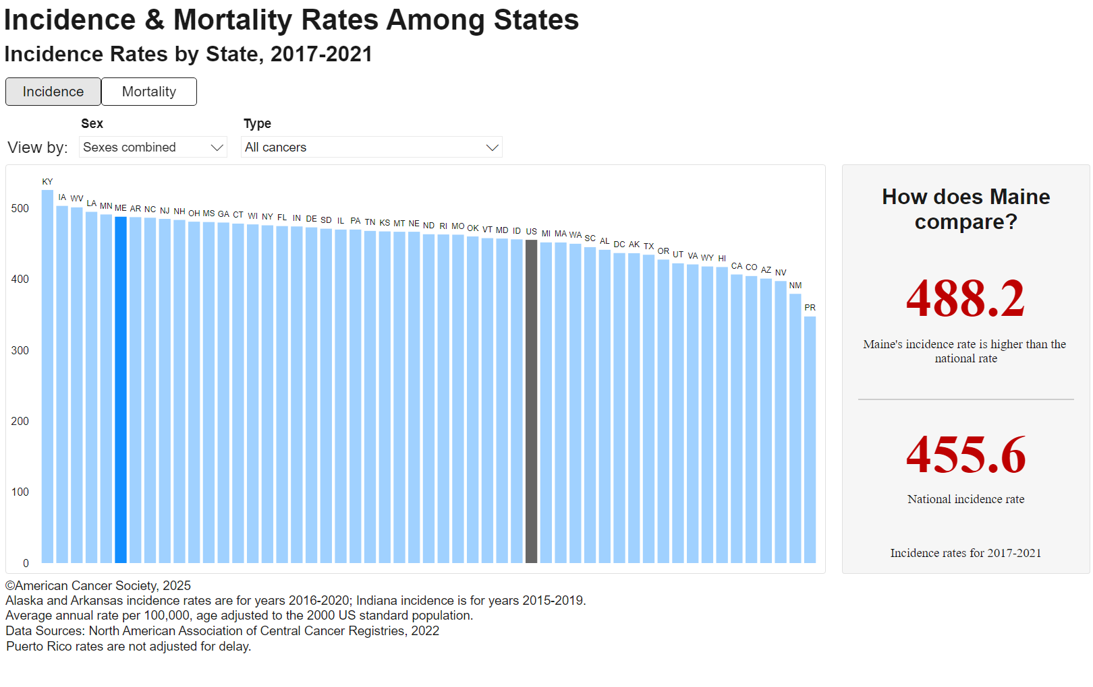
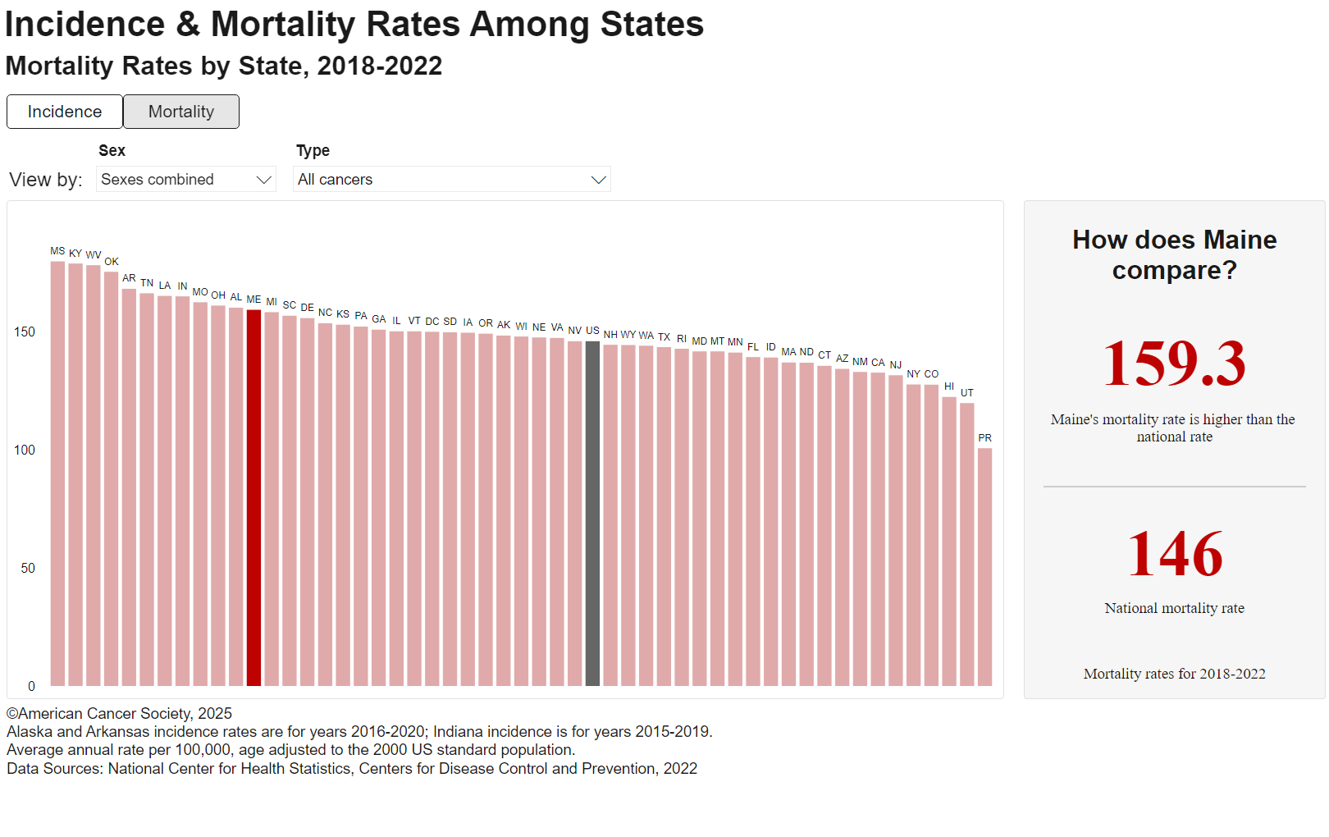
Cancer Incidence and Mortality
Maine vs. US

Slide 4
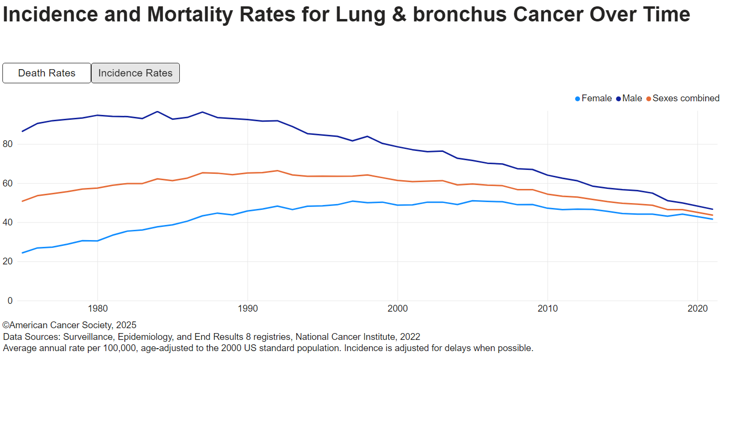
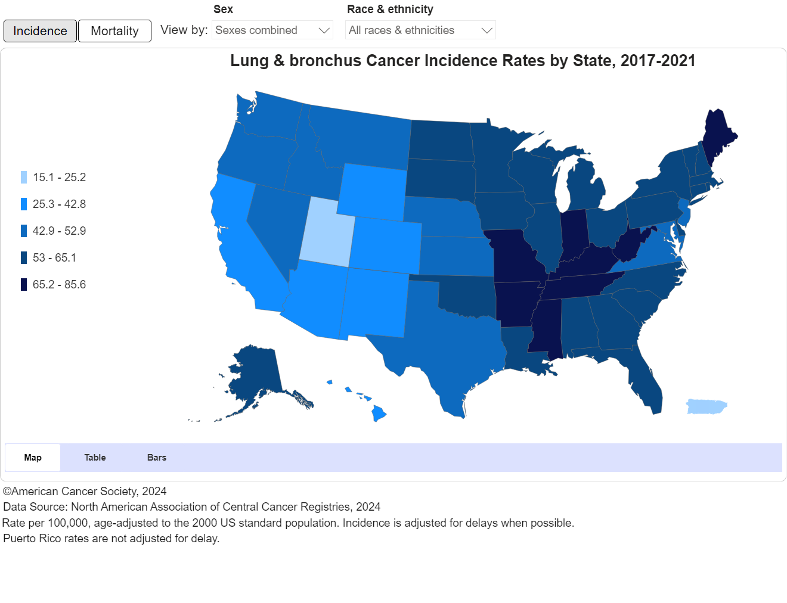
Lung Cancer Maine vs US

Slide 5
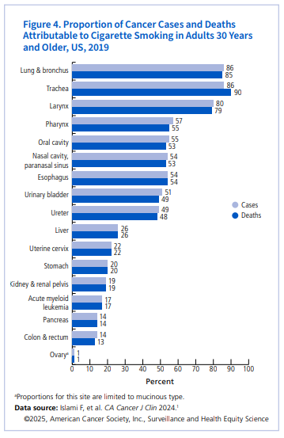
Risk Factors-Smoking
Up to 90% of lung cancers
Not just cigarettes
Quantity and duration
Per the ACS secondhand smoke is the 3rd leading cause

Slide 6
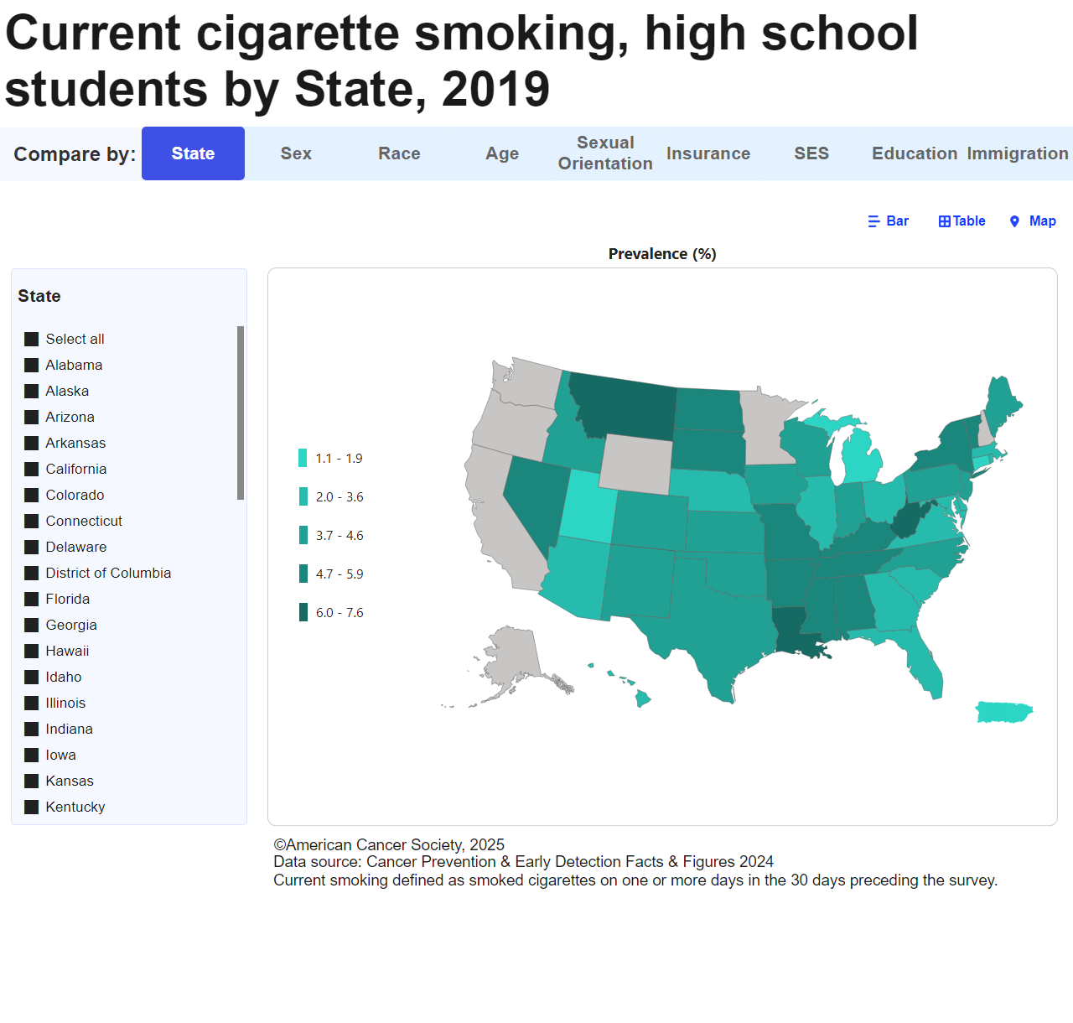
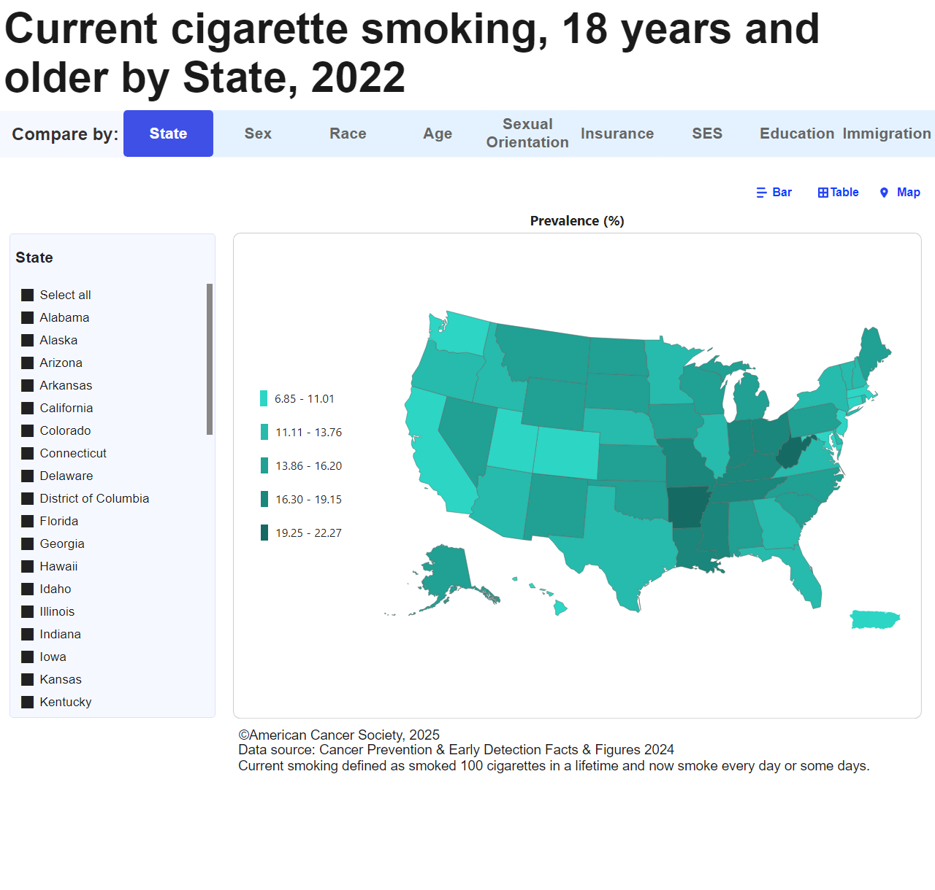
Smoking in Maine

Slide 7
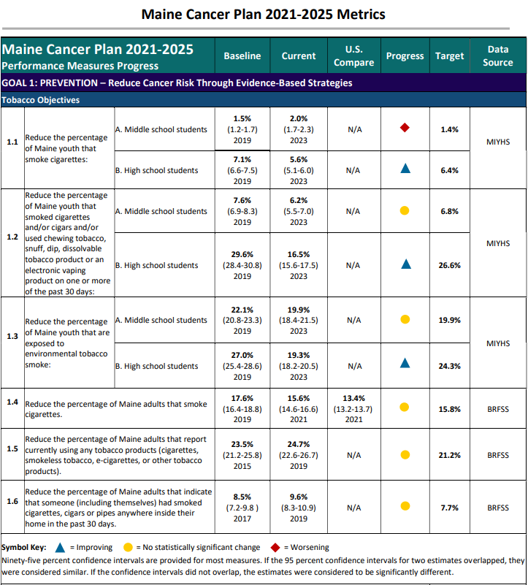
Tobacco Objectives ME Cancer Plan 2021-2025
Middle school kids→ no statistical change or worsening
High school kids→ all 3 metrics improving
Maine adults→ no statistical change in any metric

Slide 8
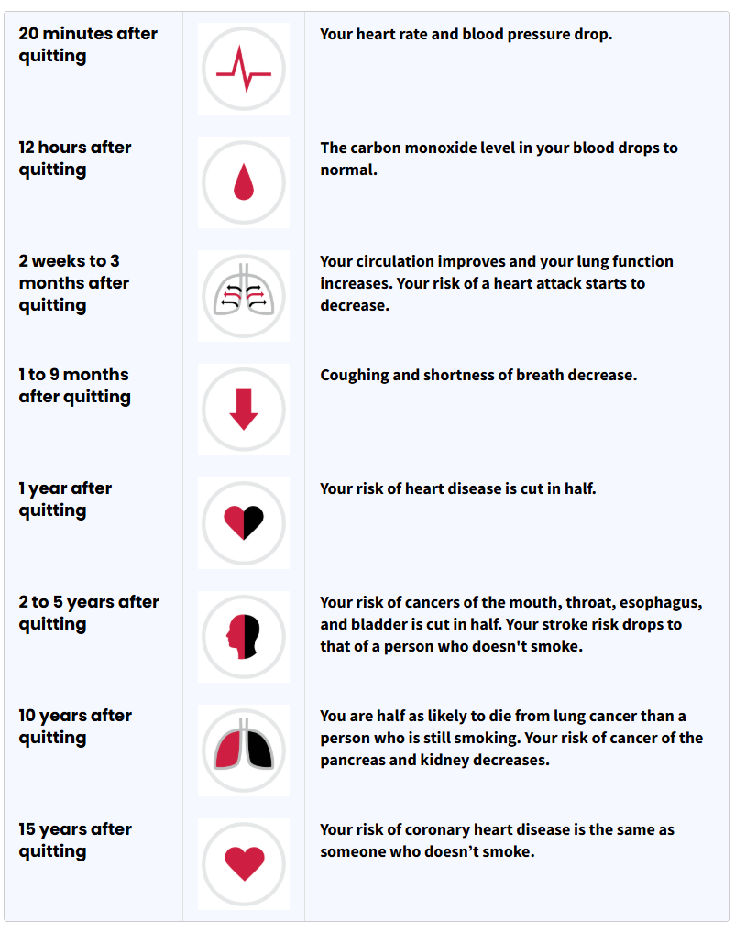

Is it Too Late to Quit?

Slide 9
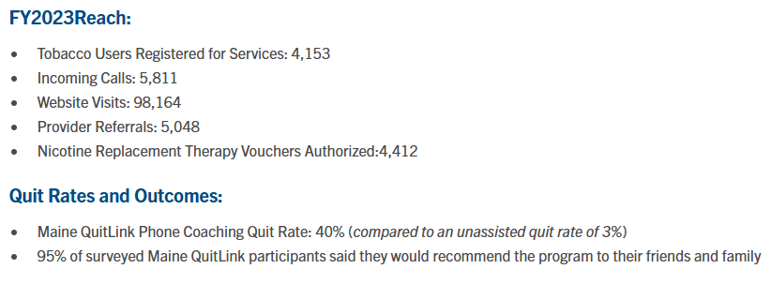
Cessation
https://mainequitlink.com/

Slide 10
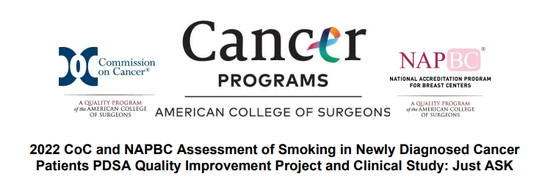
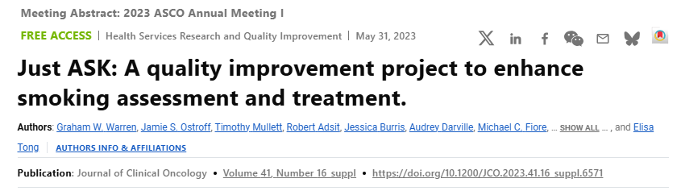
Cessation Resources
American Cancer Society Empowered to Quit email-based program
  https://youtu.be/NAOA6ckDS3E
Primary care providers
And oncology providers

Slide 11
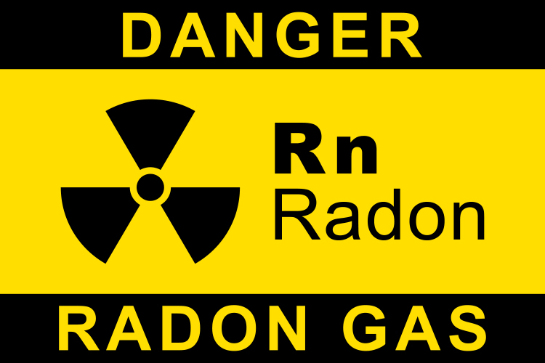
Risk Factors-Radon
2nd leading cause of lung cancer and #1 cause in non-smokers
Add smoking→lung cancer risk is 10-20X greater
Maine is the 3rd worst state for radon-induced lung cancer
1/3 homes in Maine vs 1/15 in US

Slide 12
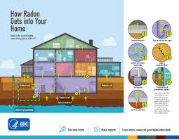
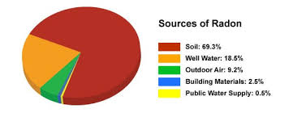
Radon

Slide 13
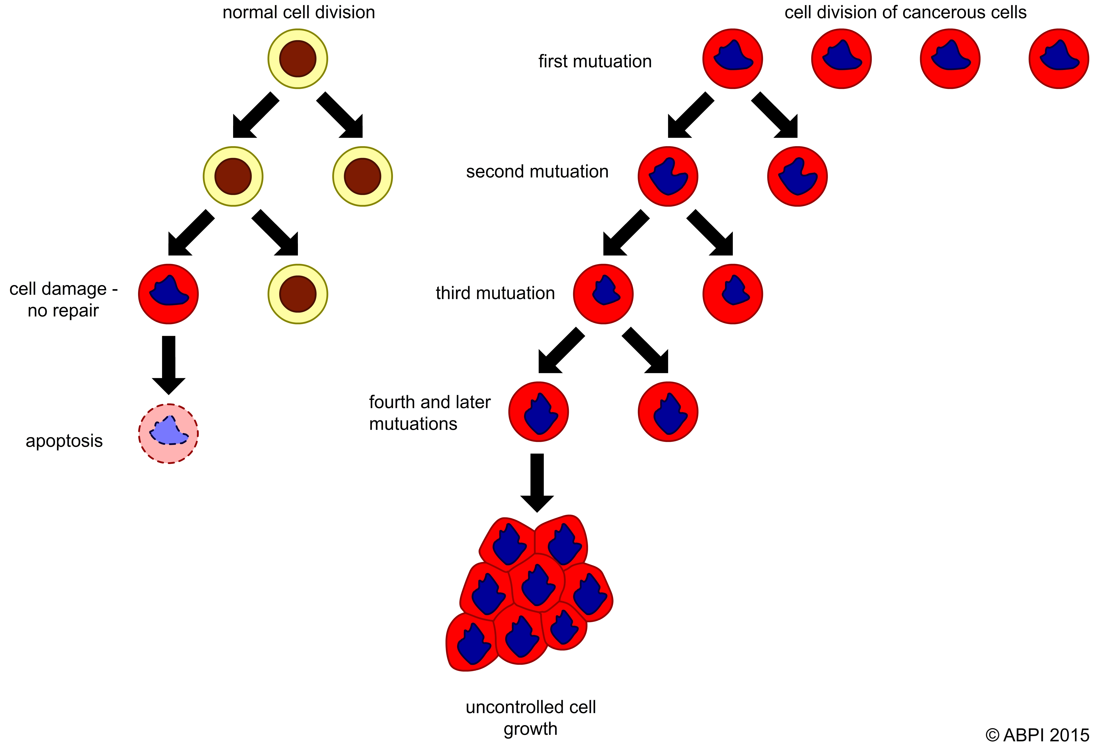
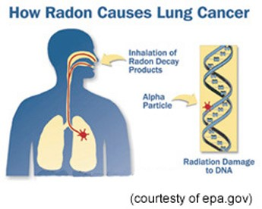
Radon

Slide 14
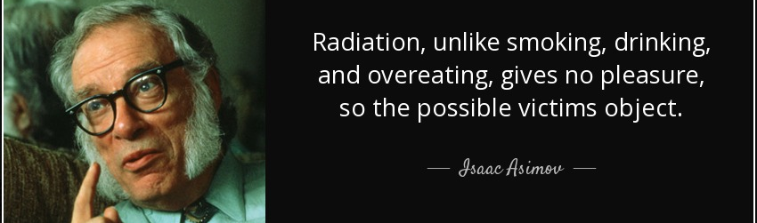
Radon
Tasteless, odorless & colorless
Prevention is key
Increase public awareness
Test test test! Air & water
Mitigate
FreeMEFromLungCancer.org

Slide 15
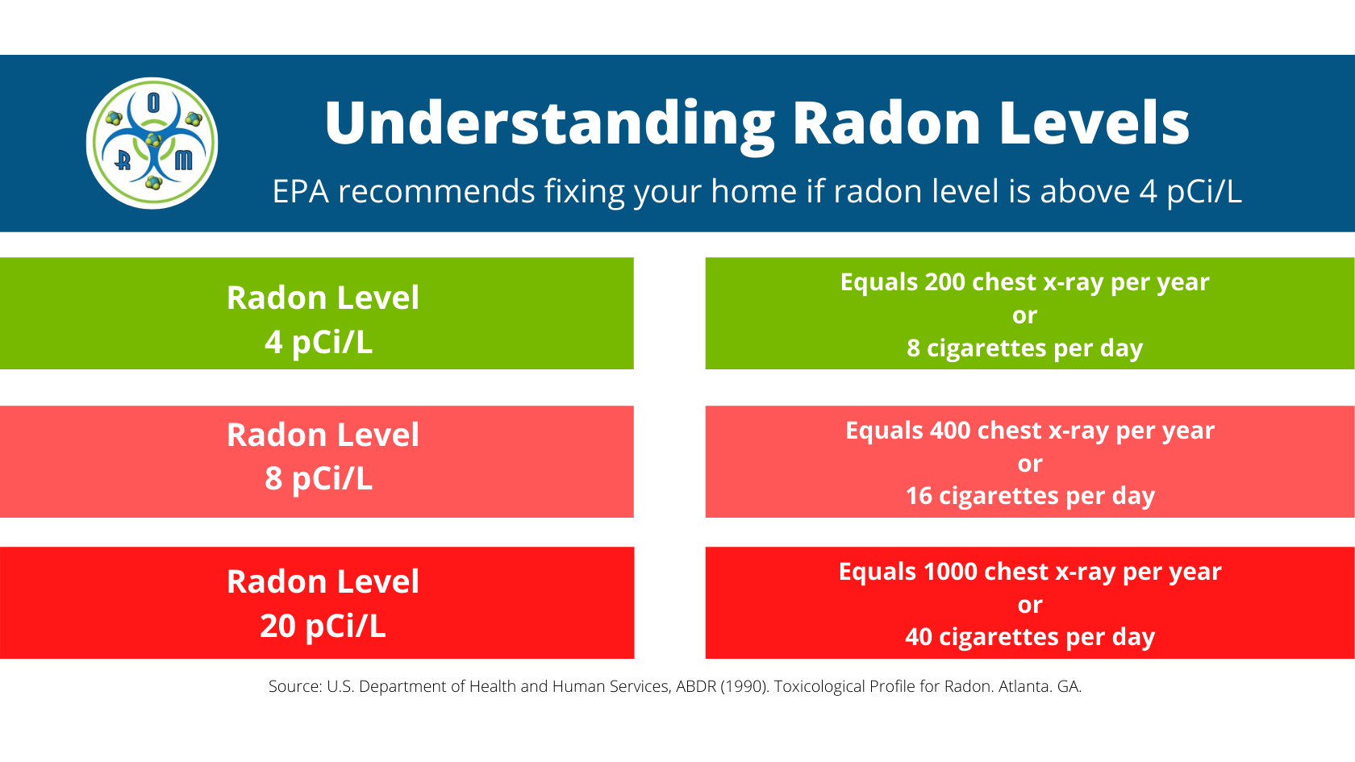
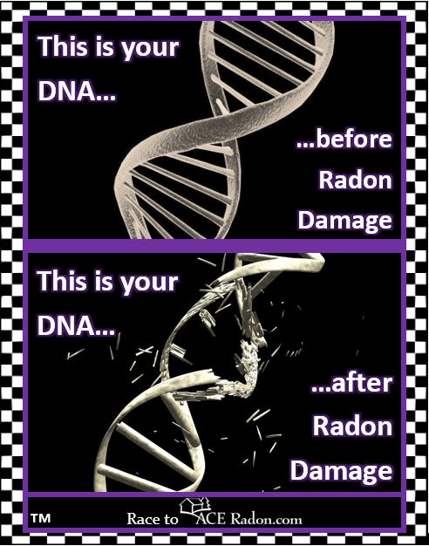
Radon Gas
What Harm Can It Do? (cont.)
Maine Center for Disease Control and Prevention
Notes:
8 cigarettes/day = 146 packs/year

Slide 16
Risk Factors-Other
Asbestos
Radioactive ores
Inhaled chemicals
Diesel exhaust
Smoking marijuana
Vaping, e-cigarettes

Slide 17
Lung Cancer Screening
A little history…
National Lung Cancer Screening Trial (NLST) published 2011
US Preventative Services Task Force (USPSTF) 2013
USPSTF 2021 update
Principle benefit is a reduction in lung cancer-specific deaths

Slide 18
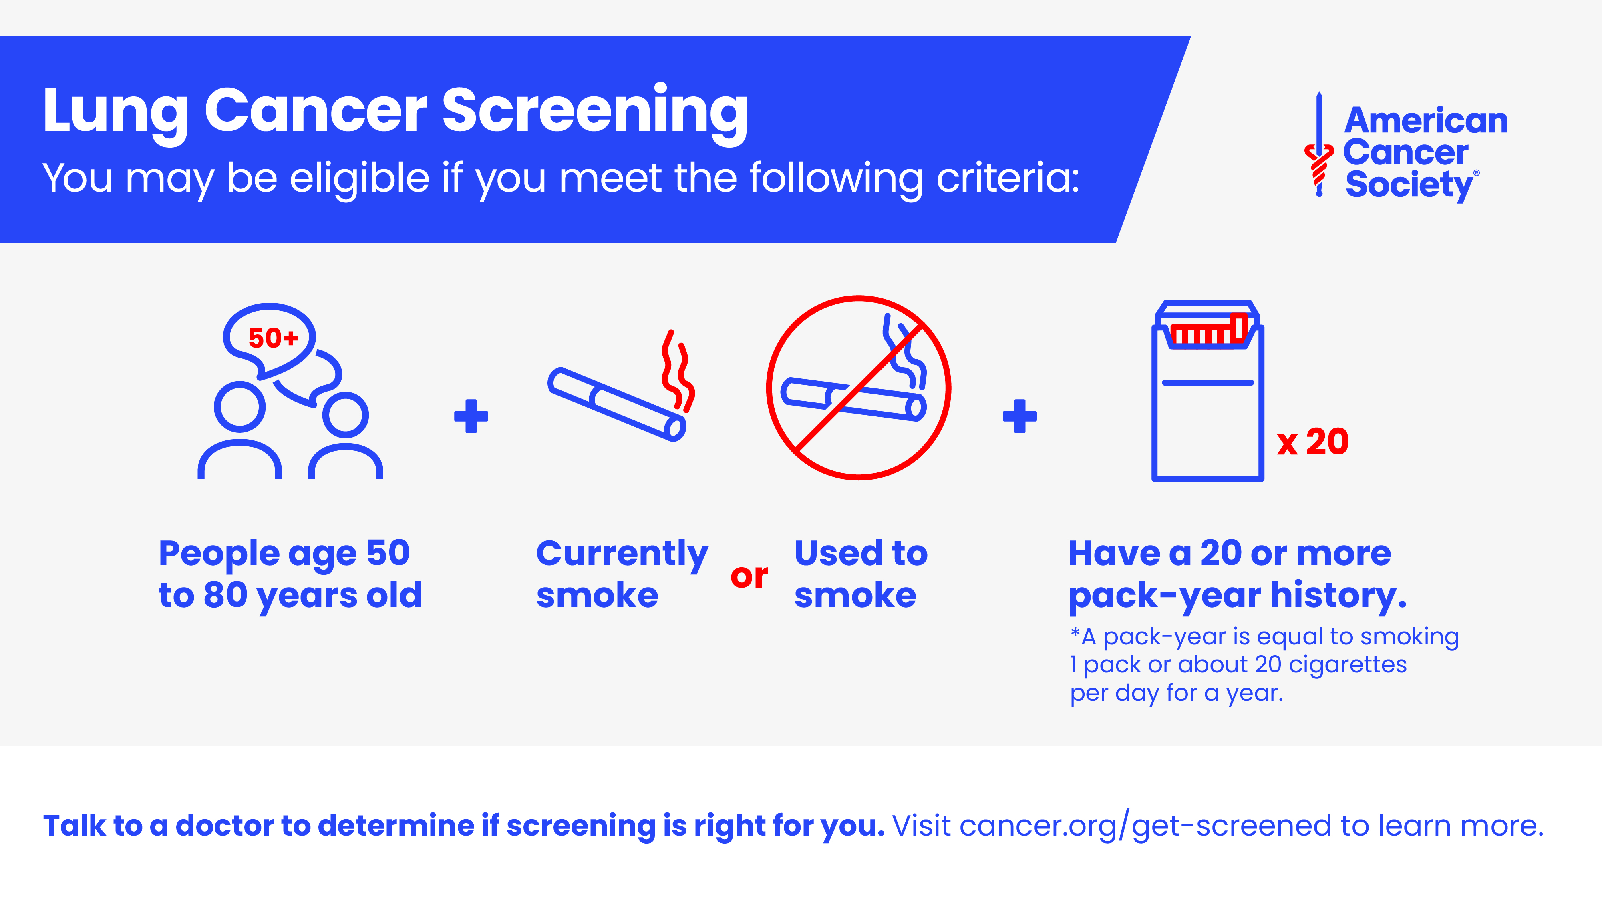

Slide 19
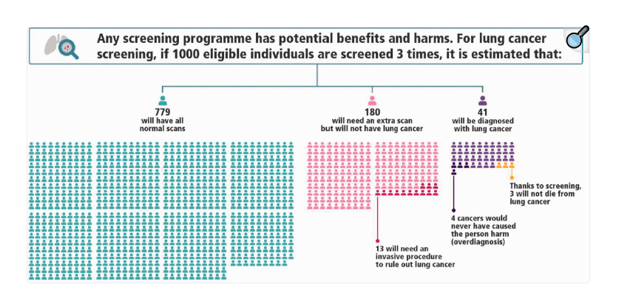
Lung Cancer Screening
https://www.youtube.com/watch?v=gBRXdzAuPD4
Shared decision making
Tobacco treatment

Slide 20
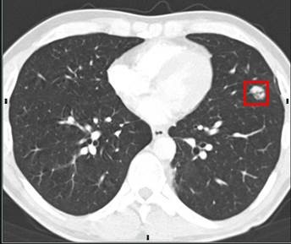
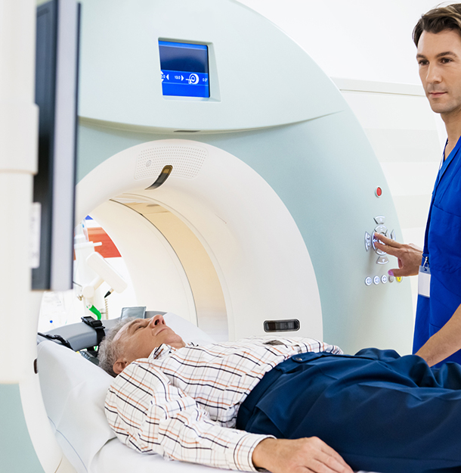
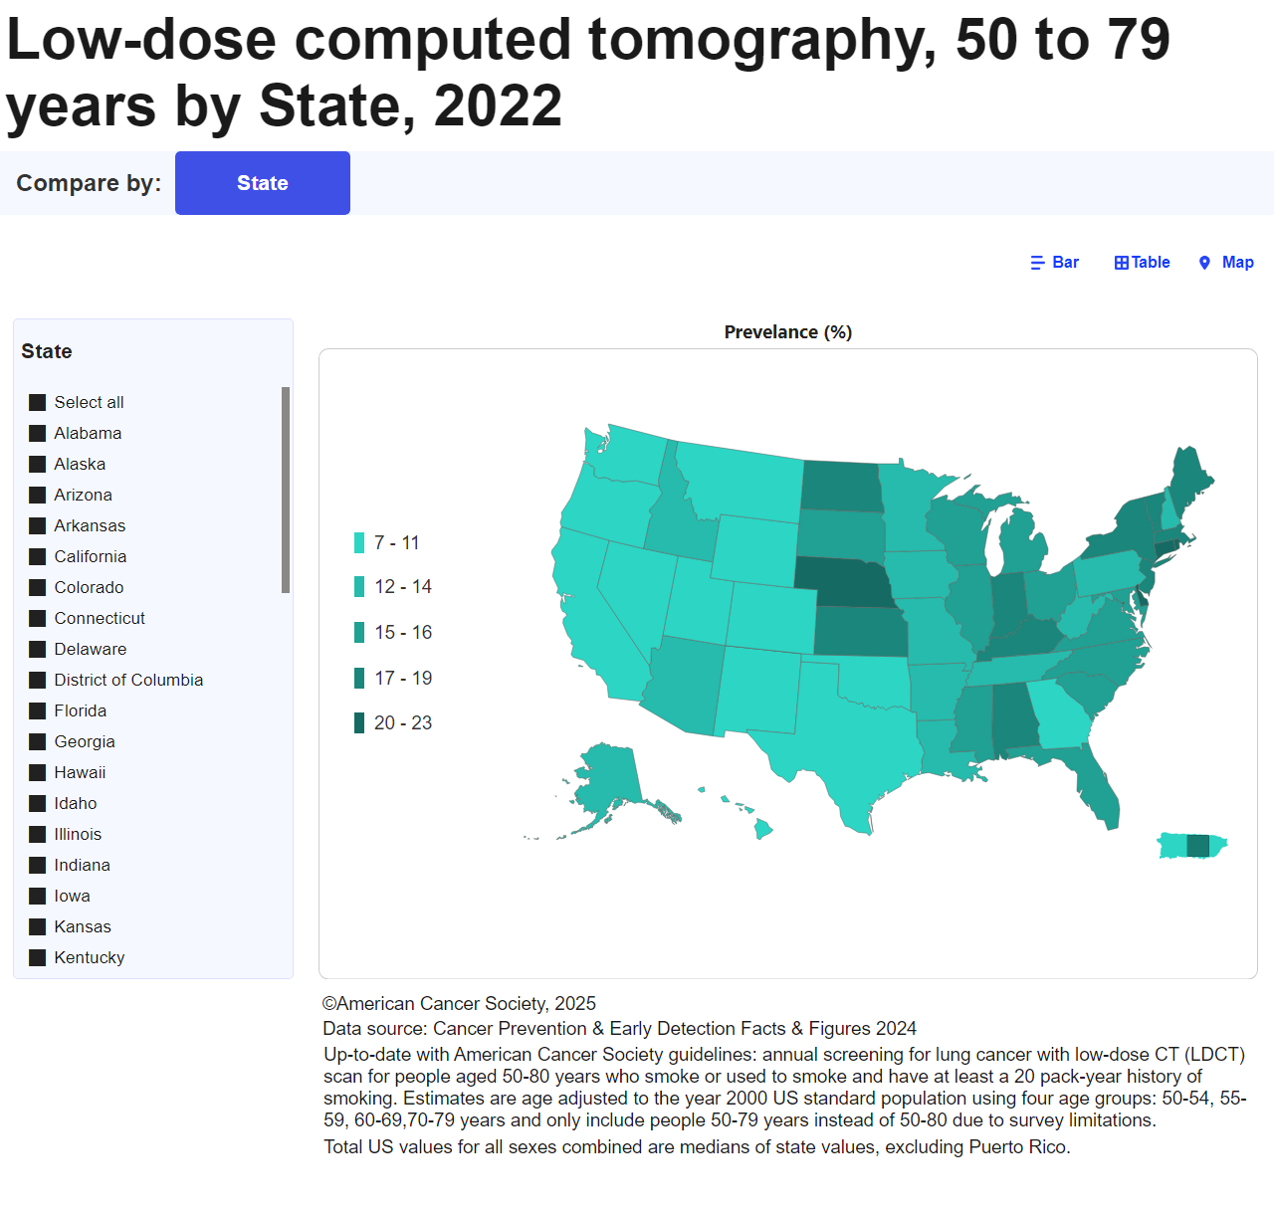
Low Dose Non-Contrast Chest CT

Slide 21
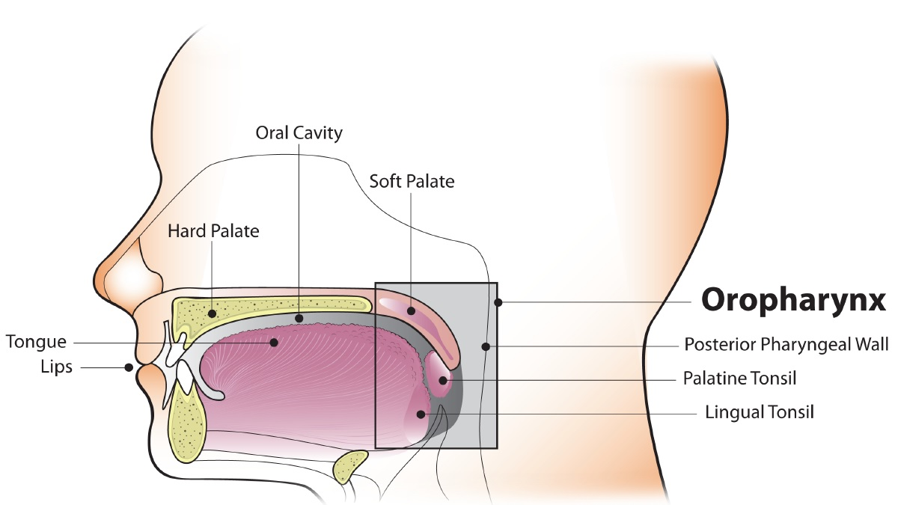
Oropharyngeal (OP) Cancer
Incidence rates and mortality are increasing
Human Papilloma Virus (HPV) > 70% of cases in the US
Healthy non-smoking White men ages 35-55

Slide 22
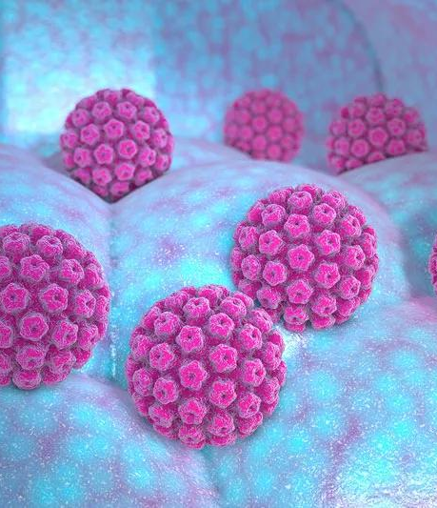
HPV
Ubiquitous: > 80% of Americans will have an HPV infection in their lifetime
Linked to 6 different cancers ~ 35K diagnosed each year
Males vs females
~1% of individuals with a high-risk HPV infection develop cancer
No visible oral signs of infection

Slide 23
Prevention-the Cancer Shot
1983
HPV causes cervical cancer
2006
HPV4 licensed and approved by the FDA for girls ages 9-26
2011
Routine use in males recommended
2014
HPV9
2019
100 countries incorporated HPV vaccination into their regular vaccine schedule
2020
Expanded FDA indication-for all other HPV associated cancers

Slide 24
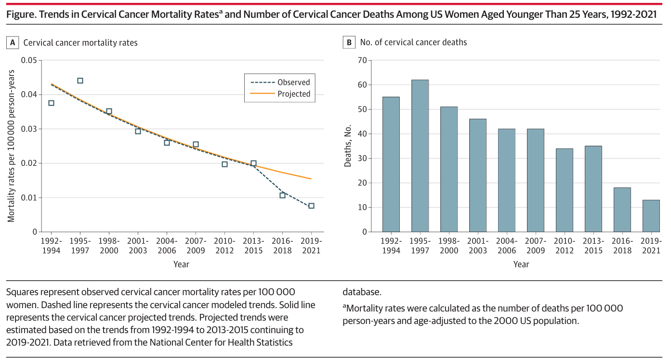
Cervical Cancer-A Success Story

Slide 25
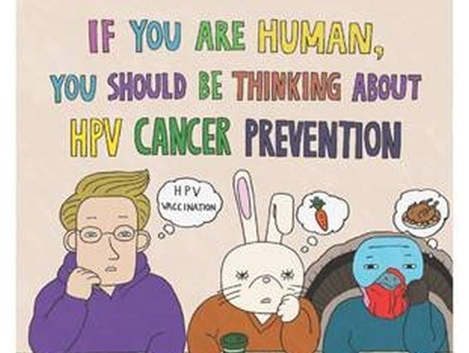
Prevention-the Cancer Shot
Messaging very important!
Be creative
  MCF funded dental pilot
Benefits of starting vaccine series at age 9
  Finish series
  Better immune response
  Fewer # of shots needed
>90% of HPV cancers prevented
Maine 66% vs 61% completion rate by age 13 (2022 data)
Safe. No impacts on fertility HPV Vaccination: Just the Facts from ACS

Slide 26
Survivorship Implications
Neck pain/spasms/weakness Fatigue
Trismus Dental problems
Dysphagia Self-image
Altered taste Increased stroke risk
Hearing loss/vertigo/imbalance Depression/anxiety
Problems with phonation Neurocognitive changes
Dry mouth Lymphedema
Hypothyroidism Aspiration

Slide 27
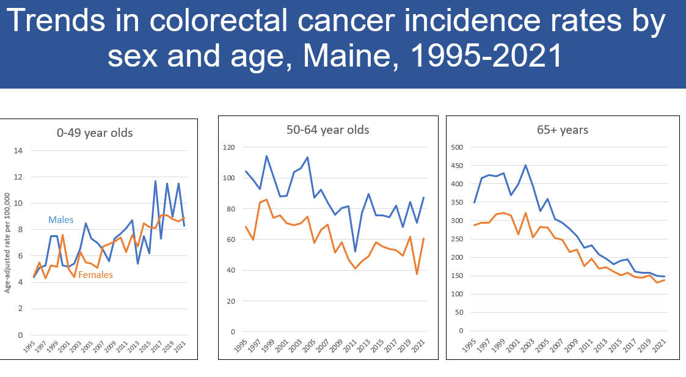
Colorectal Cancer (CRC)

Slide 28
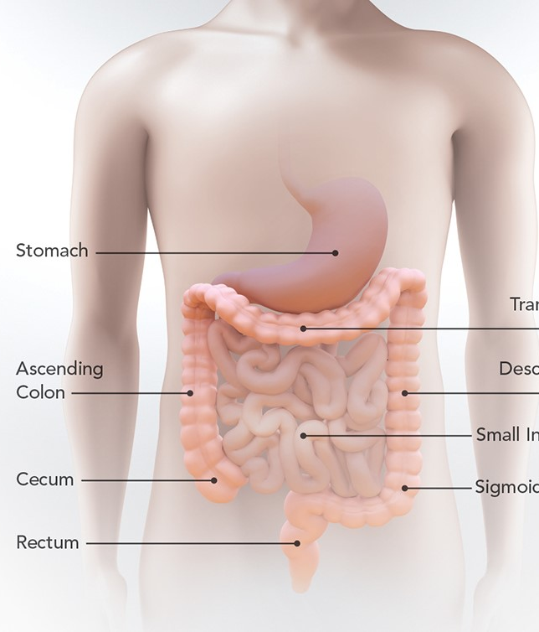
Risk Factors
Physical inactivity
Unhealthy nutrition
Obesity
Smoking
Alcohol consumption

Slide 29
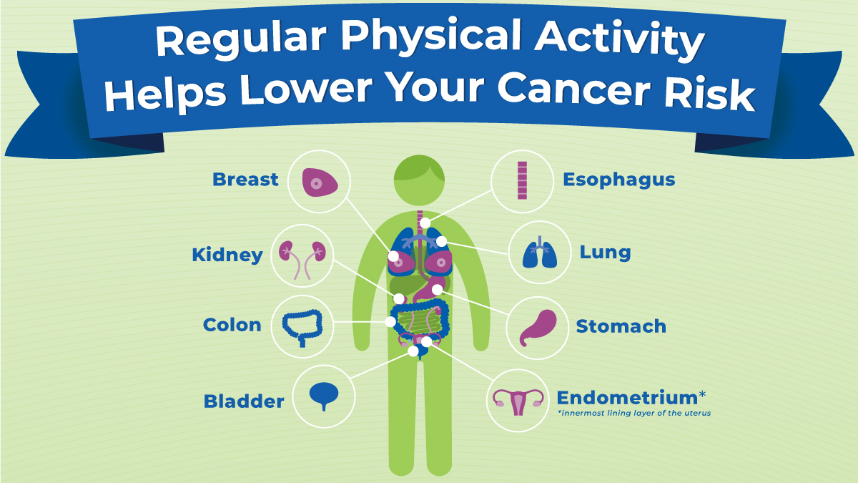
Healthy Movement
150-300 minutes of moderate intensity or 75-150 minutes of vigorous intensity each week

Slide 30

Healthy Nutrition
Variety of fruits and veggies
Whole grains
Legumes
Lean proteins
Fermented foods
Limit processed foods, red & processed meats, sugar-sweetened beverages

Slide 31

Alcohol
Direct irritant
Facilitates absorption of carcinogens
Metabolized to acetyl aldehyde
Increases oxidative stress
Raises hormone levels

Slide 32
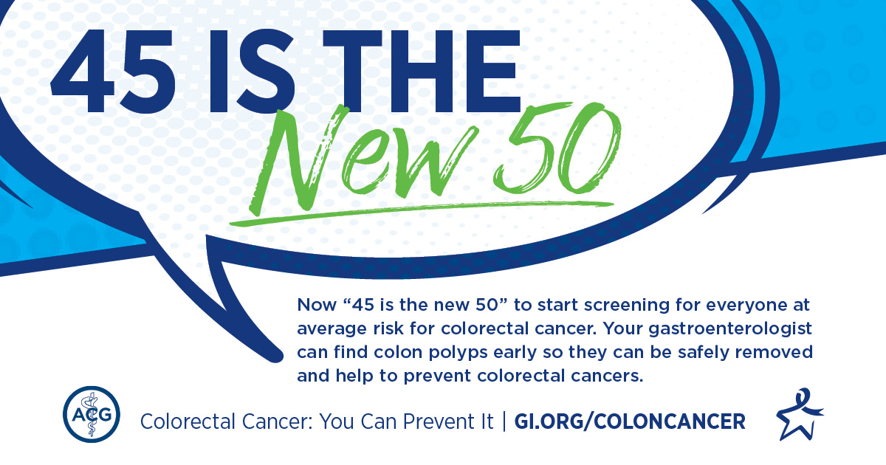
CRC Screening
Guideline Update 2021

Slide 33
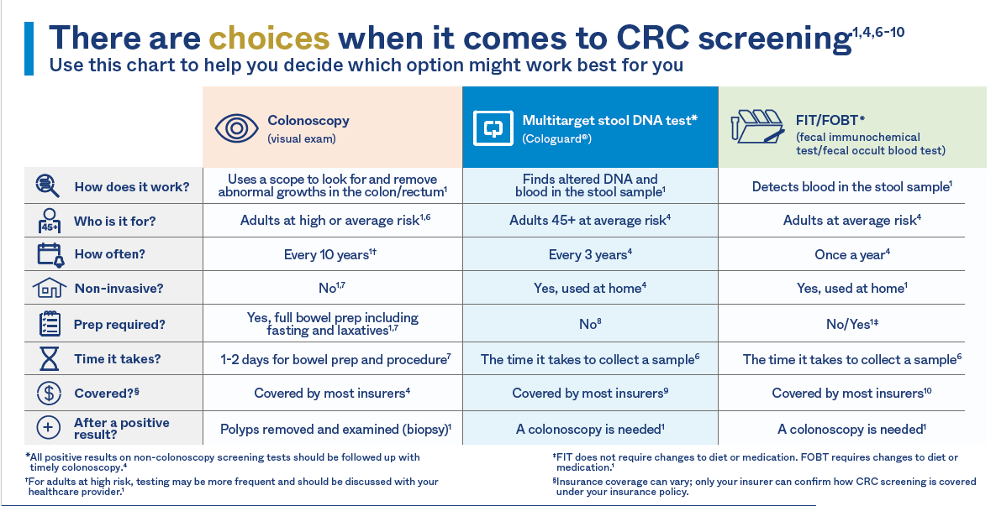
CRC Screening

Slide 34
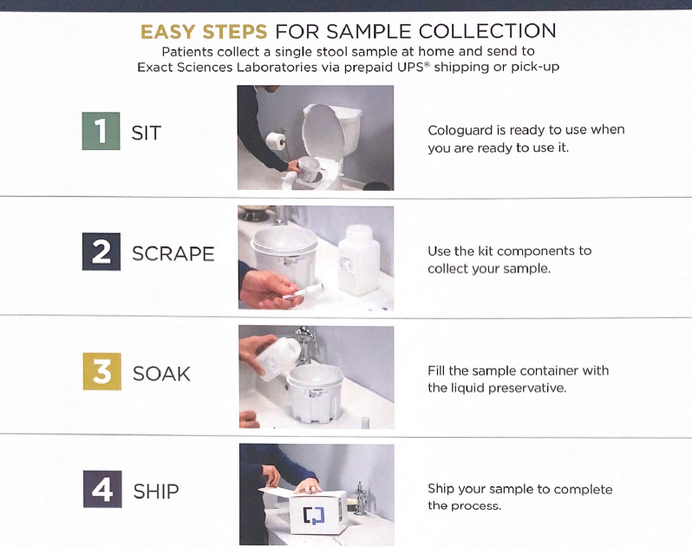
What’s Missing From This Picture?

Slide 35


Slide 36
IMPORTANT COVERAGE CHANGE:
In 2023, Medicare, ACA and commercial plans cover, as part of preventive care and screening, a follow-up colonoscopy after a stool-based test returns a positive or abnormal result for patients 45 years of age and older.

Slide 37
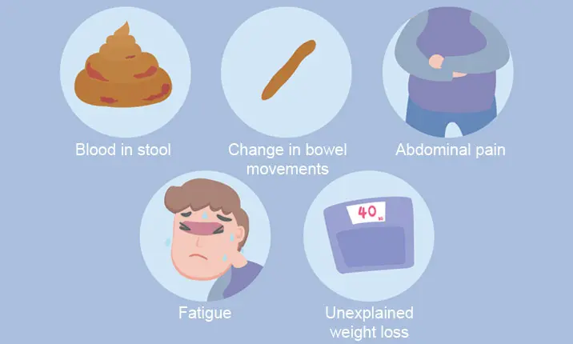
Do Not Ignore Symptoms!

Slide 38
Survivorship Implications
Financial toxicity
Infertility
Relationships
Mental health
Body image
Live longer with long-term effects & develop late effects from treatment

Slide 39
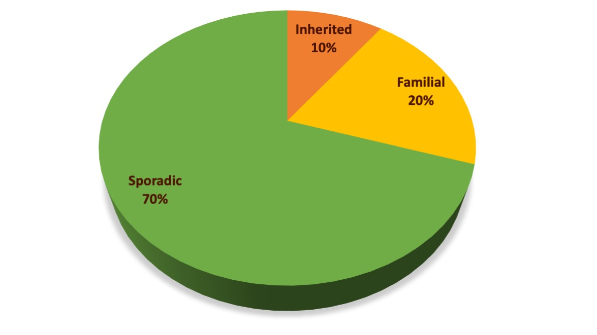
Types of Cancer

Slide 40
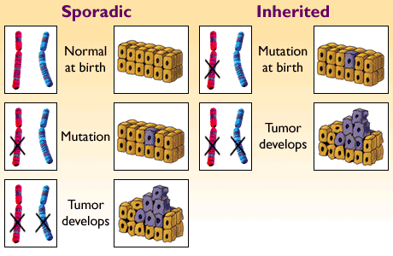
Sporadic vs Inherited aka Hereditary

Slide 41

Hereditary Cancer
Rare cancer type
Young cancer
Strong family history
Certain ancestries
Guideline driven prevention
Guideline driven early detection
Clinical trial opportunities

Slide 42
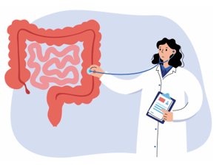
How Management Changes
Average Risk for Colon Cancer
Lynch Syndrome (1/35 CRCs)
Begin CRC screening at age 45
Variety of CRC screening options
First degree relative with CRC or high risk colon polyps
Begin screening at age 40 & screen every 5 years ideally with colonoscopy
Begin CRC screening at ages 20-25
Colonoscopy only
Stomach & small bowel cancer
Uterine and ovarian cancer
Ureteral and bladder cancer
Pancreatic cancer
Prostate cancer

Slide 43

Know Your Risk!

Slide 44

In Summary
Too much cancer and too many cancer deaths in Maine.
Smoking #1. Chronic radon exposure #1.
LDLCT
HPV associated OP cancer
Cancer shot
45 is the new 50
Don’t ignore symptoms
Know your risk!

Slide 45

Thank you!
Dr. Carolyn Bancroft ME CDC
Gretchen Sminkey ME CDC
Jessica Reed ME Primary Care Assoc
Dr. Neil Korsen ME Lung Cancer Coalition
Jon Dyer ME CDC
Deb Violette Free ME From Lung Cancer
Nicole Heanssler Am Cancer Society

