Slide 1

Bridging Health Gaps: The Role of Community Health Workers in Cancer Screening for Immigrant Populations
Maine's Impact Cancer Network's 2025 Cancer Conference
May 1, 2025, Freeport, ME
Marin Johnson, MS | Director of Prevention Programs & CHW Program | Preventive Medicine Enhancement for Maine
Grace Lapika | Community Health Worker | Preventive Medicine Enhancement for Maine
Tobias Nicholson, MD, ScM | Leadership in Preventive Medicine Fellow | MaineHealth

Slide 2

Disclosures
The presenters have no actual or potential conflicts of interest in relation to this presentation.

Slide 3
Learning Objectives
By the end of this presentation, attendees will be able to:
Describe the role of a community health worker as integrated into the larger clinical care team
Recognize barriers to cancer screening for immigrant populations
Examine opportunities for community health workers to engage patients in obtaining appropriate cancer screening
Identify strategies for community health workers to encourage patients to incorporate lifestyle changes for cancer prevention

Slide 4
The Preventive Medicine Enhancement for Maine
Community Informed Care Initiative
The PrevME CICI addresses gaps in health care delivery, access and care plan implementation experienced by non-English speaking and other disenfranchised communities in the greater Portland area.
Together, we work in intersection between communities and health systems to promote care.

Slide 5
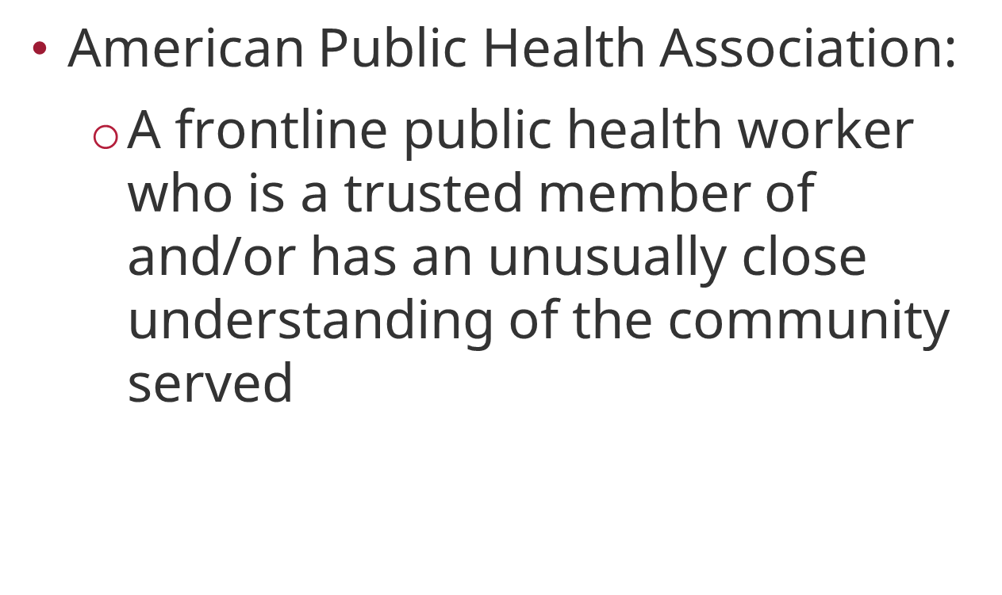
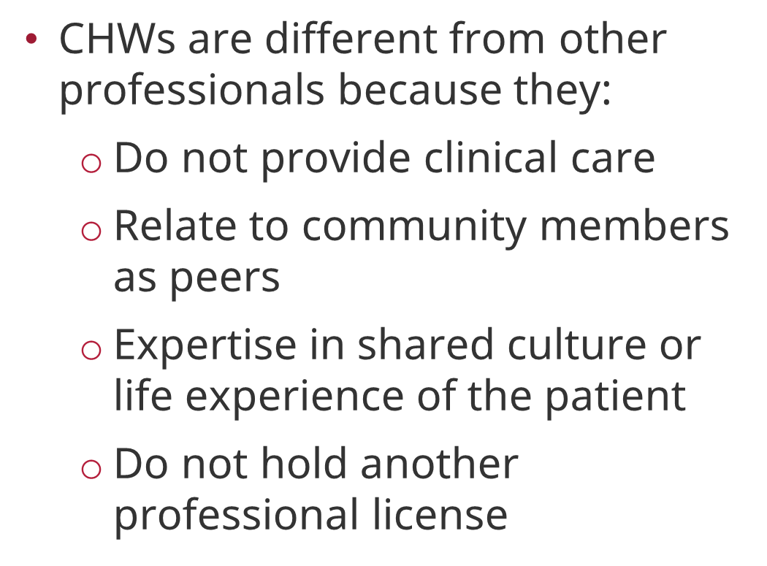

Community Health Workers
Community Health Worker Definition
Unique Characteristics

Slide 6



CHW Roles
Screen and Assist: SDoH
Set Goals
Educate & Promote
Health Maintenance
Administer SDOH screening tools
Connect patients to available resources
Document screening results/referrals
Follow-up with patients
Improve Trust and provide patient support
Create community-clinical linkages
Review patients' health concerns
Review patients' health record
Set goals to improve conditions, upcoming or past visits/due dates, adhering to care plan
Help patients navigate health care systems, connect to appropriate health care teams
Educate patients and families on lifestyle changes, medication adherence, and treatment
Track and support patient progress on care plan to improve health outcomes
Increase cultural humility of care team

Slide 7

Patient Stories
I felt supported and like someone understood what I was going through. It is hard to be in a country where you do not know the language and are unable to connect with certain professionals.
She is really good at checking in on me and always remembers our last conversation, even when I don’t I feel listened to.
It is great to know that there is someone that was once as confused as I was and is now so educated in many things that I believe I can one day do the same for other people in my community.

Slide 8
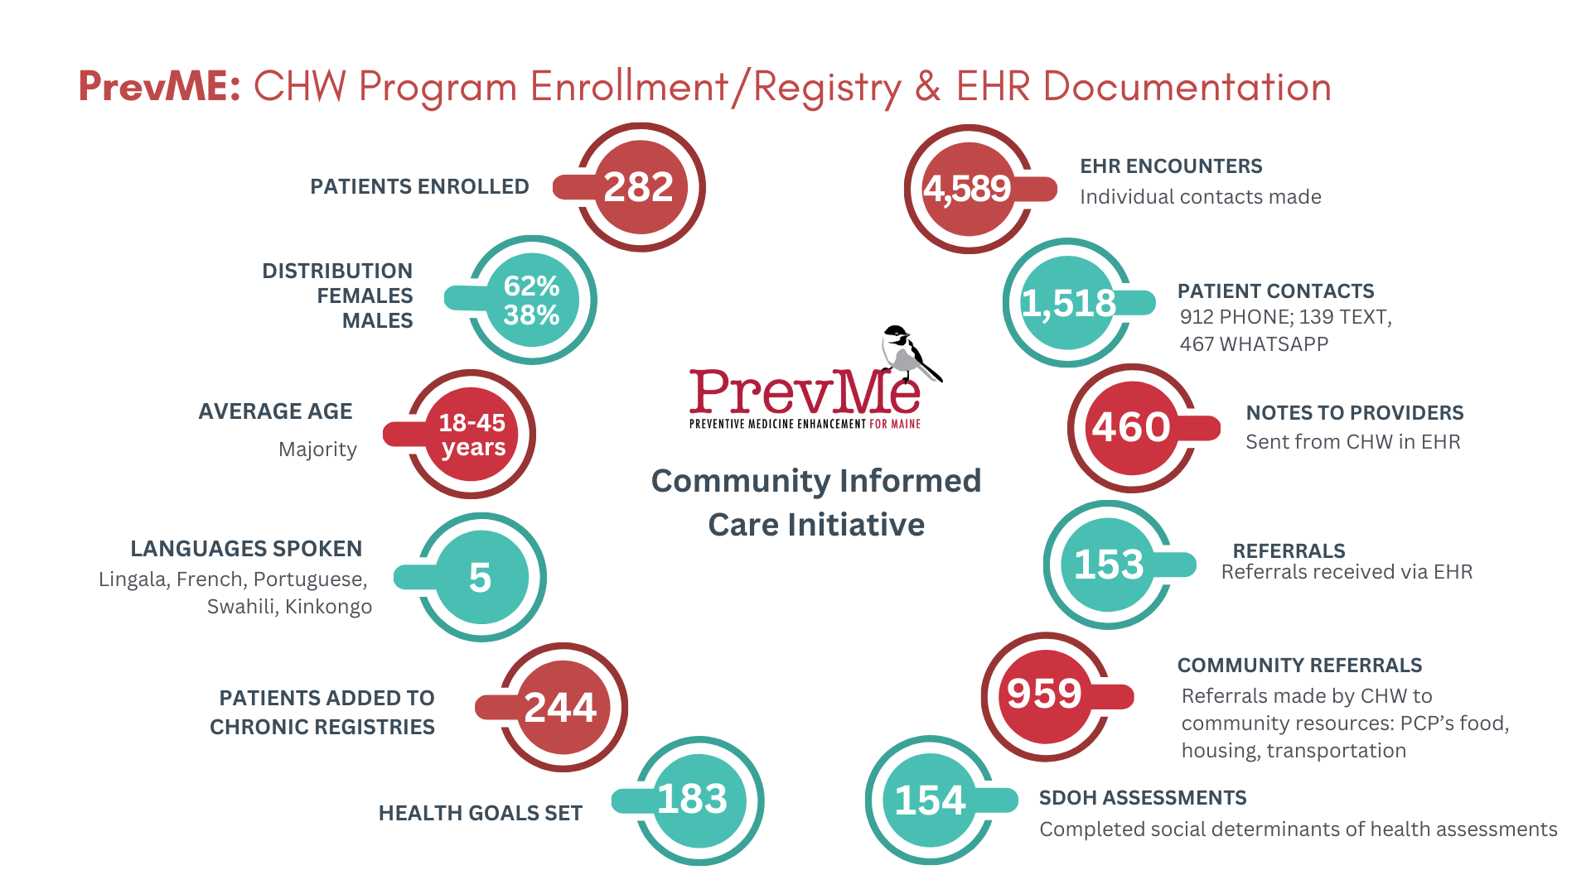
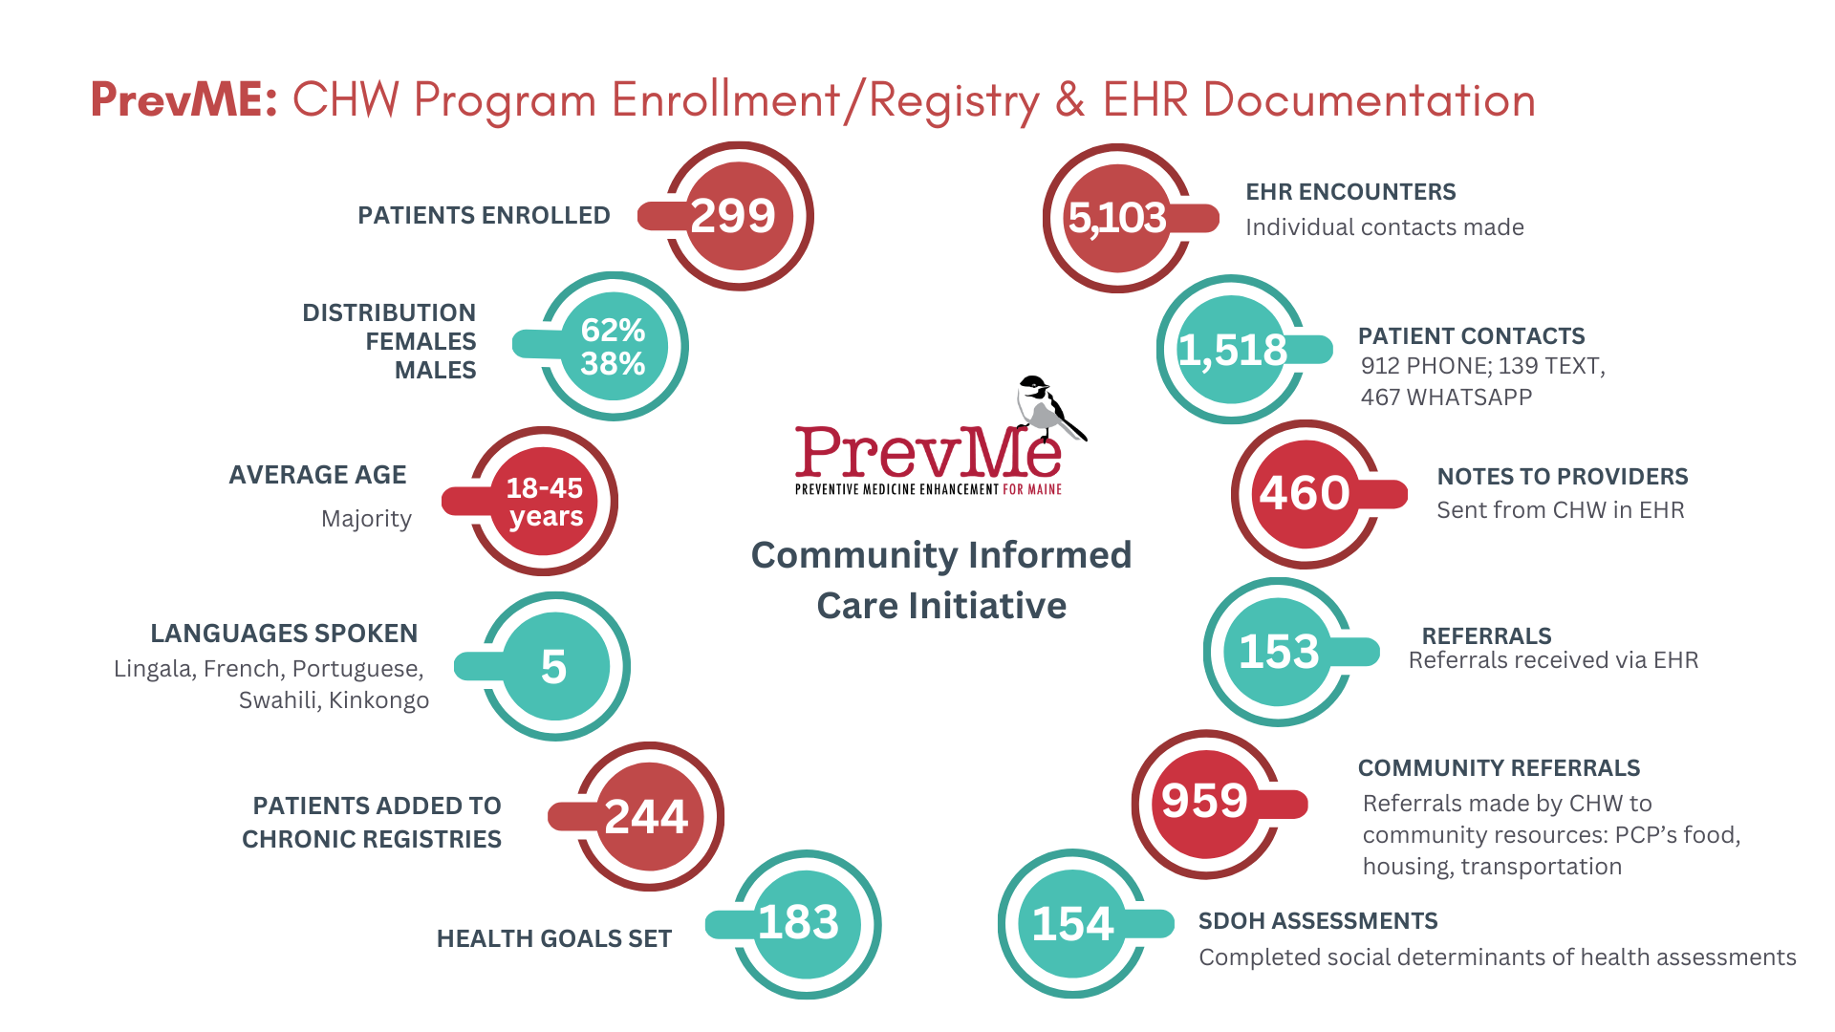

Slide 9
Screening and Prevention in Immigrant
Communities
Perceptions and uptake of cancer screening in Sub-Saharan African populations are shaped by an interplay of:
Cultural beliefs (religiosity, fatalism, health temporal orientation, acculturation)
Economic barriers (insurance coverage, work coverage, childcare coverage)
Healthcare infrastructure limitations (access to care in US, (un)availability of testing in US and in country of origin)
Notes:
Sharma A, Alatise OI, O'Connell K, et al. Healthcare utilisation, cancer screening and potential barriers to accessing cancer care in rural South West Nigeria: a cross-sectional study. BMJ Open. 2021;11(7):e040352. Published 2021 Jul 26. doi:10.1136/bmjopen-2020-040352
Adegboyega A, Wiggins AT, Obielodan O, Dignan M, Schoenberg N. Beliefs associated with cancer screening behaviors among African Americans and Sub-Saharan African immigrant adults: a cross-sectional study. BMC Public Health. 2022;22(1):2219. Published 2022 Nov 29. doi:10.1186/s12889-022-14591-x

Slide 10
Strategies for CHWs in Screening and Prevention

Slide 11
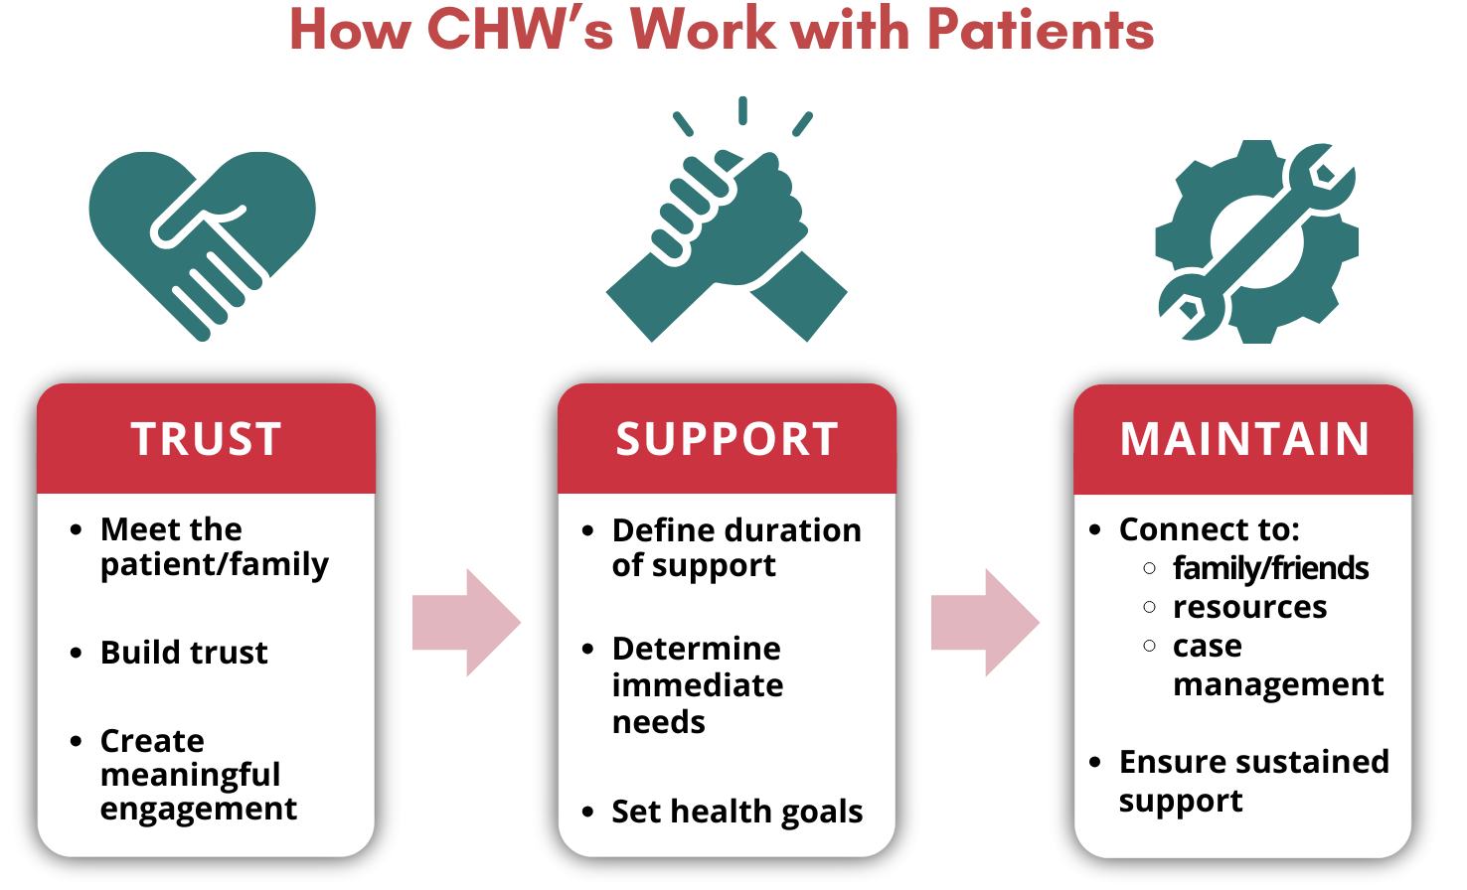

Slide 12
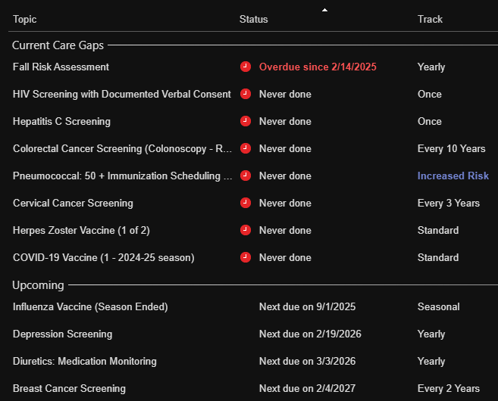
CHW Strategies: Screening
Patient Conversations
Use the Health Maintenance Tab in EPIC: This tool shows overdue screenings or vaccines with red indicators.
Explain due or overdue cancer screenings in plain language and with cultural humility and understanding
Educate Patients About What and Why: Many patients may not understand the purpose of cancer screenings or think they’re only needed when symptoms appear.
Discuss patient screening history with provider
Help patient schedule and get transportation to screening appointments

Slide 13



CHW Strategies: Prevention
Healthy Eating
Active Living
Health Goals
Do you ever try adding more vegetables or drinking more water?
Do you ever read the labels on food when you go grocery shopping?
Reading food labels can help you make healthier choices—like avoiding too much sugar, salt, or unhealthy fats.
What kind of physical activity do you enjoy, even just walking?
I can assist you with getting a YMCA membership. I’ll also provide you with bus tickets and a pair of sneakers so you can get started comfortably?
Do you have access to stairs at home or nearby? Using the stairs for 30 minutes a day can be a great way to stay active.
Have you heard about routine health exams?
What do you usually do to stay healthy?
Can we aim for 30 minutes of exercise 5 days a week?
Can you try to eat at least 3 servings of fruits and raw vegetables/day?
Can we set reminders on your phone for when to take your medications?
Can you check your blood pressure once a day?

Slide 14

And Scene...

Slide 15
Role of a CHW Team in Screening and Prevention

Slide 16



Team Roles: Supervisor, Coordinator,
Clinical Advisor
Education
Chart Review
Supporting CHWs
Bi-weekly clinical education provided by MD clinical advisor
Varying topics, tailored to CHW discussion with patients
Ongoing professional development searches by supervisor for CHW growth and further education
Review enrolled patients for screening gaps
Review patient’s risk factors for targeted goal setting, prevention efforts
Team discussions on patient care approaches, barriers and successes
Available to CHWs for clinical questions and concerns
Weekly team meetings with entire team to review
Daily check ins with CHWs and supervisor roles to review questions/concerns

Slide 17
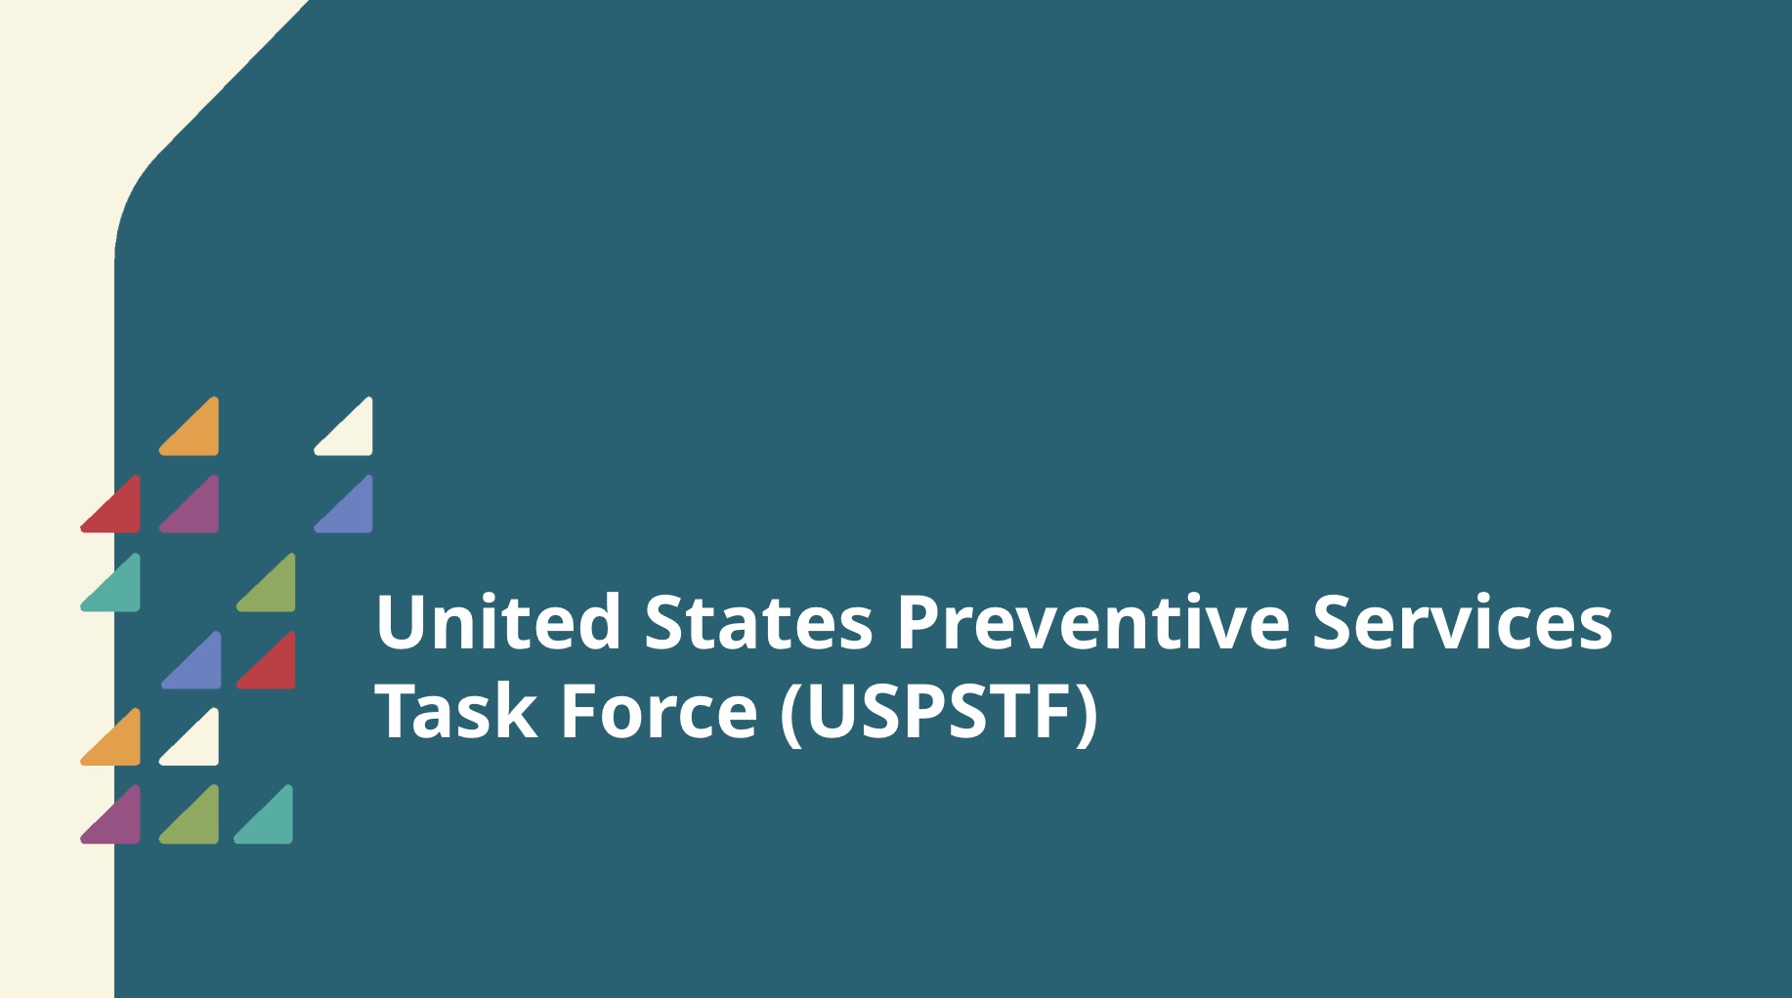
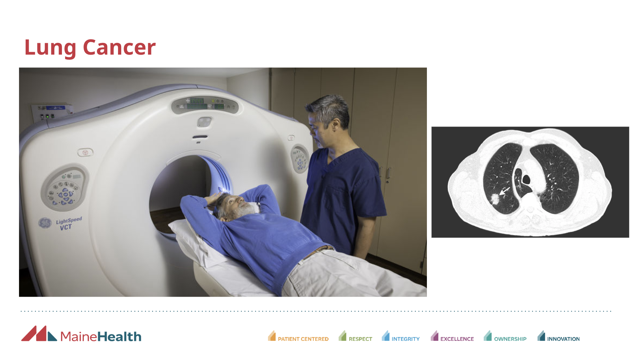
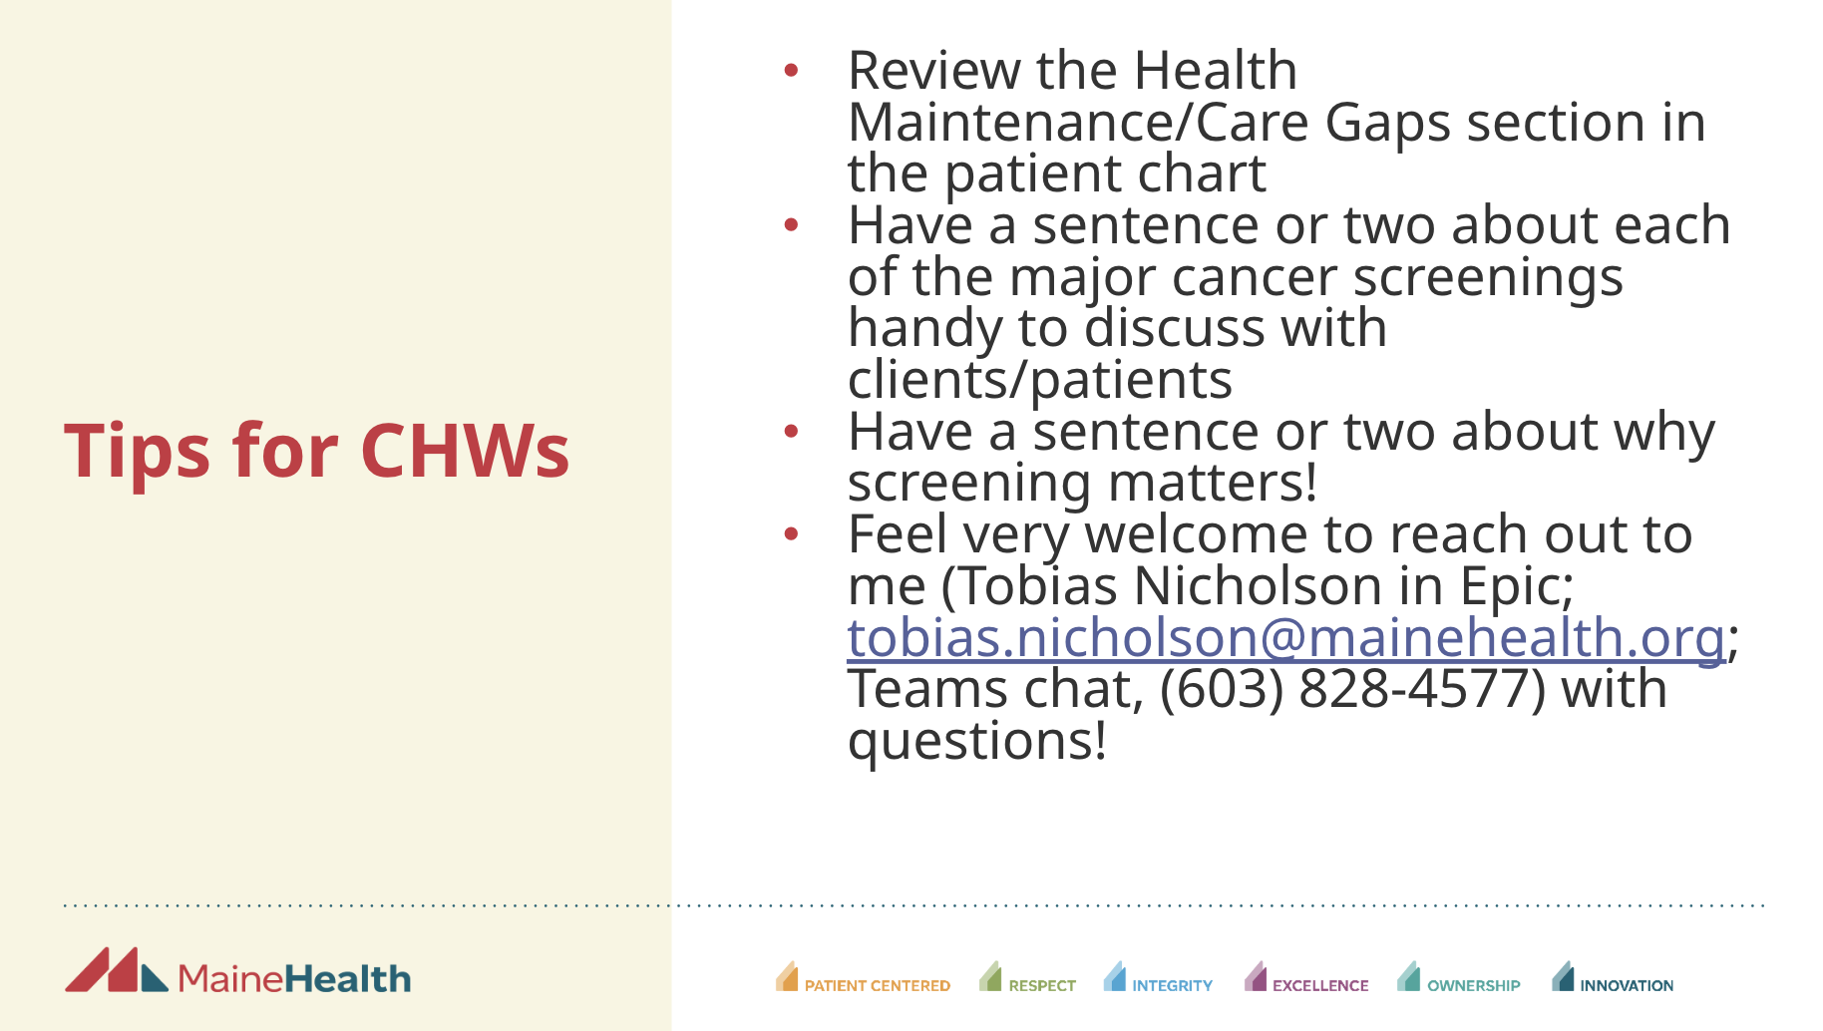
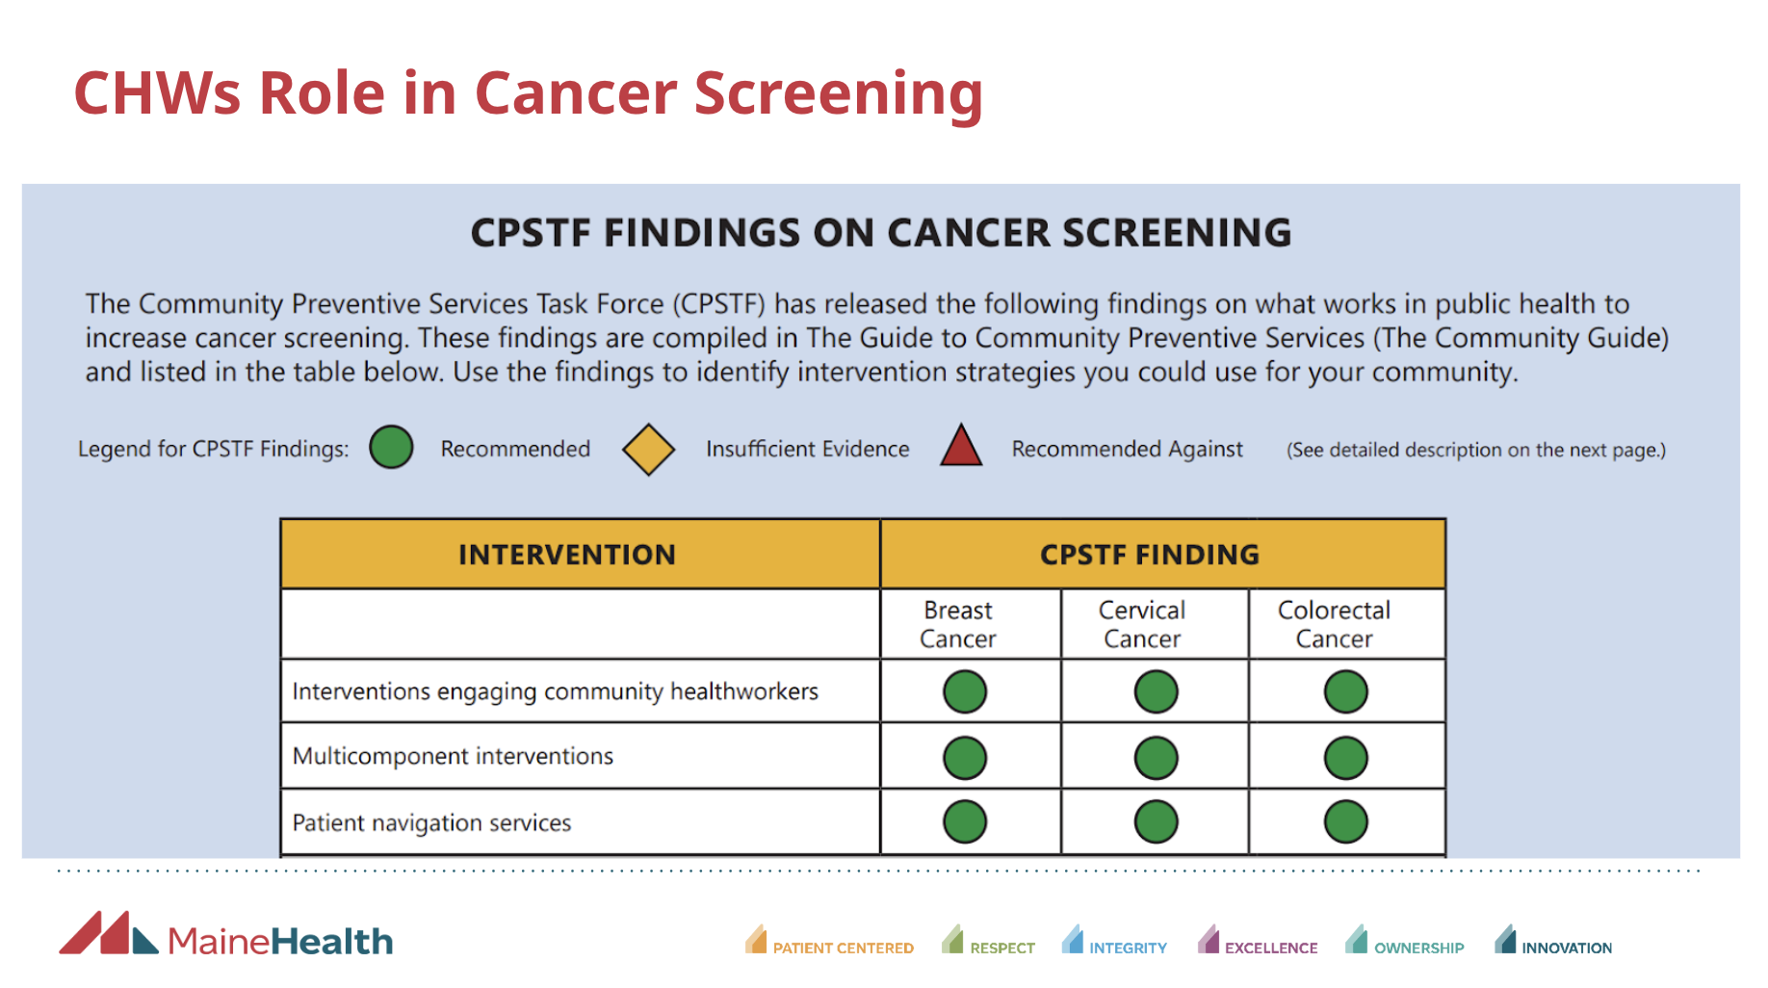
CHW Clinical Education

Slide 18
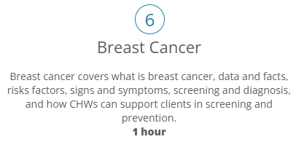

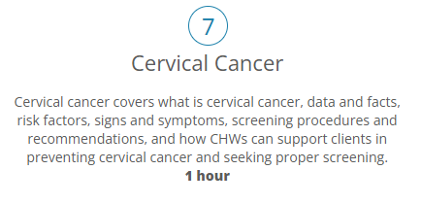
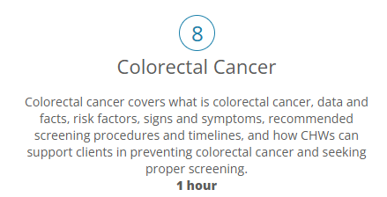
Medical Care Development (MCD)
CHW Training

Slide 19
Evidence-Based Intervention

Slide 20
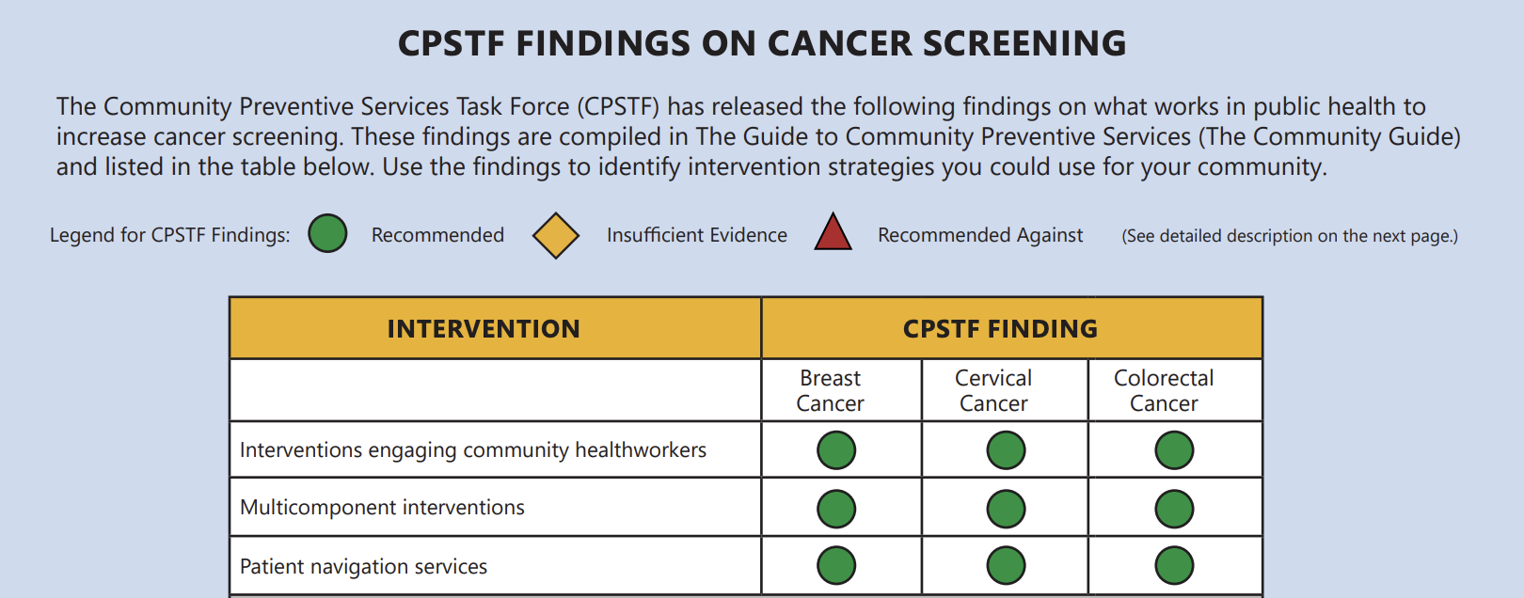
CHWs Role in Cancer Screening
Notes:
https://www.thecommunityguide.org/pages/task-force-findings-cancer-prevention-and-control.html

Slide 21
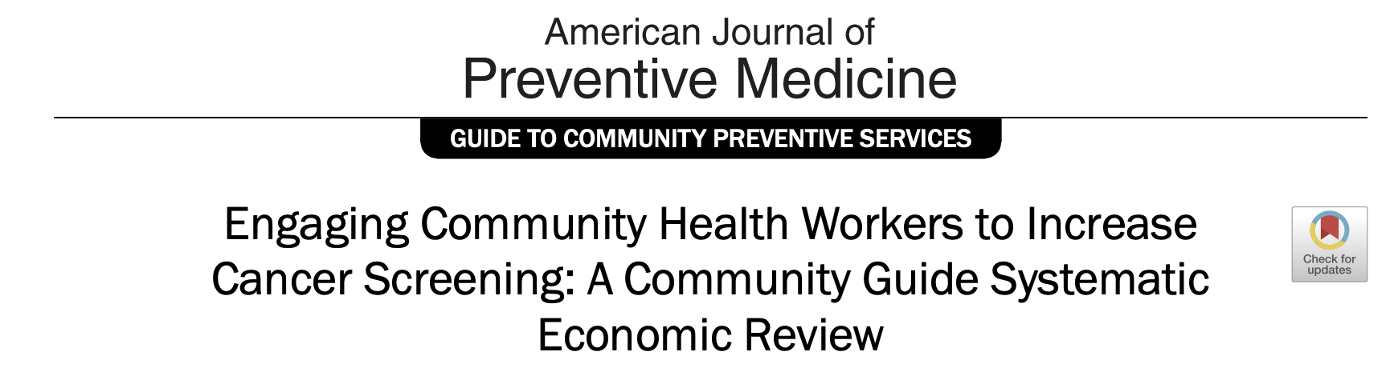
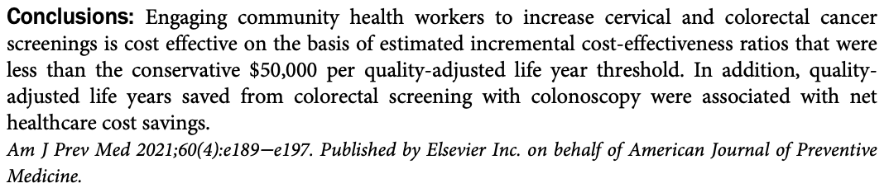
Notes:
https://www.thecommunityguide.org/media/pdf/cancer-ajpm-ecrev-community-health-workers.pdf
Attipoe-Dorcoo S, Chattopadhyay SK, Verughese J, et al. Engaging Community Health Workers to Increase Cancer Screening: A Community Guide Systematic Economic Review. Am J Prev Med. 2021;60(4):e189-e197. doi:10.1016/j.amepre.2020.08.011

Slide 22
How to Connect to a CHW
MaineHealth Patient (MaineHealth PCP or gone to MaineHealth ED): refer to CICI CHW program! chw@mainehealth.org
There are many community based organizations in the State that accept referrals via FindHelp.org
Ask your patients if they have ever or are currently working with a CHW

Slide 23
Questions? Concerns? Compliments?
marin.johnson@mainehealth.org
grace.lapika@mainehealth.org
tobias.nicholson@mainehealth.org

