Slide 1
LGBTQ+ Affirming Cancer Screening in Primary Care
Maine's Impact Cancer Network's 2025 Cancer Conference
May 1, 2025
Jennifer Daigle (she/her), APRN-CNP | Clinical Program Coordinator | Greater Portland Health
Tobias Nicholson (he/him), MD, ScM | Leadership in Preventive Medicine Fellow | MaineHealth

Slide 2
Learning Objectives
By the end of this presentation, learners should be able to:
Describe disparities in cancer screening and common barriers to cancer screening for LGBTQ+ patients
Explain the concept of an anatomy survey/organ inventory and how it applies to cancer screening
Implement current best practice cancer screening recommendations for LGBTQ+ patients with a focus on TGD patients

Slide 3
Disparities

Slide 4



Cancer-Related Health Disparities for LGBTQ+ Patients
Increased Risk Factor Exposure
Limited Data
Multiple Screening Recommendations
Minority stress leads to increased exposure to cancer risk factors¹
Higher prevalence of smoking and alcohol use; HIV and HPV infections^{2,3}
Less likely to be up to date with recommended screening for many reasons including discrimination, stigma²
Limited data exist to examine cancer incidence and prevalence for a variety of reasons, inconsistent collection of SOGI information being a major contributor⁴
Limited data result in limited evidence-based recommendations
Conflicting recommendations between society guidelines/expert opinions⁵
Notes:
Reisner SL, Pardo ST, Gamarel KE, White Hughto JM, Pardee DJ, Keo-Meier CL. Substance Use to Cope with Stigma in Healthcare Among U.S. Female-to-Male Trans Masculine Adults. LGBT Health. 2015;2(4):324-332. doi:10.1089/lgbt.2015.0001
Leone AG, Trapani D, Schabath MB, et al. Cancer in Transgender and Gender-Diverse Persons: A Review. JAMA Oncol. 2023;9(4):556-563. doi:10.1001/jamaoncol.2022.7173
Buchting, F. O., Emory, K. T., Kim, Y., Fagan, P., Vera, L. E., & Emery, S. (2017). Transgender use of cigarettes, cigars, and e-cigarettes in a national study. American journal of preventive medicine, 53(1), e1-e7.
Huang AK, Hoatson T, Chakraborty P, et al. Disparities in cancer incidence by sexual orientation. Cancer. 2024; 1-9. doi:10.1002/cncr.35356
Parikh U, Mausner E, Chhor CM, Gao Y, Karrington I, Heller SL. Breast Imaging in Transgender Patients: What the Radiologist Should Know. Radiographics. 2020;40(1):13-27. doi:10.1148/rg.2020190044

Slide 5
Barriers to Screening

Slide 6




Barriers to Cancer Screening for LGBTQ+ Patients
Medical Mistrust
Provider Discomfort
Provider Knowledge
Patient Knowledge
LGBTQ+ adults are 2-3 times more likely to report having a negative experience in healthcare setting and avoiding care because of it^{1, 2}
~50% of TGD patients report being refused care, misgendered, having a provider use harsh language or be physically rough because of their gender identity³
~30% of LGBTQ+ adults educated providers so they could get appropriate care^{4,5}
Providers less likely to recommend screening to LGBTQ+ patients^{6,7}
LGBTQ+ patients are more likely to have knowledge gaps regarding cancer risk which in turn limits completion of recommended screening^{6,7,8}
Notes:
https://www.kff.org/report-section/lgbt-adults-experiences-with-discrimination-and-health-care-disparities-findings/
Jaffee KD, Shires DA, Stroumsa D. Discrimination and Delayed Health Care Among Transgender Women and Men: Implications for Improving Medical Education and Health Care Delivery. Med Care. 2016;54(11):1010-1016. doi:10.1097/MLR.0000000000000583
James, S.E., Herman, J.L., Durso, L.E., & Heng-Lehtinen, R. (2024). Early Insights: A Report of the 2022 U.S. Transgender Survey. National Center for Transgender Equality, Washington, DC
https://www.kff.org/health-policy-101-lgbtq-health-policy/?entry=table-of-contents-stigma-amp-discrimination
https://cancer-network.org/wp-content/uploads/2021/12/genderExpansiveReport-4.pdf
Polek, C., & Hardie, T. (2010, May). Lesbian women and knowledge about human papillomavirus. In Oncology Nursing Forum (Vol. 37, No. 3).
Haviland KS, Swette S, Kelechi T, Mueller M. Barriers and Facilitators to Cancer Screening Among LGBTQ Individuals With Cancer. Oncol Nurs Forum. 2020;47(1):44-55. doi:10.1188/20.ONF.44-55
Butame, S. A., Lawler, S., Hicks, J. T., Wilkerson, J. M., Hwang, L. Y., Baraniuk, S., ... & Nyitray, A. G. (2017). A qualitative investigation among men who have sex with men on the acceptability of performing a self-or partner anal exam to screen for anal cancer. Cancer Causes & Control, 28, 1157-1166.

Slide 7
Decreased Rates of Appropriate Screening
Organ | TGD Patients | Cis- Patients
Colon^{2,8} | 55% | 68%
Breast^{2,3,7} | 33% | 76%
Lung⁴ | 2.3% | 17.2%
Cervical^{2,3,7} | 56% | 76%
Prostate^{5,6} | 22.2% | 36.3%
Notes:
1Istl AC, Lawton S, Kamaraju S, Stolley M, Petroll AE, Cortina CS. Tumors, Treatments, and Trust: Cancer Characteristics, Outcomes, and Screening Uptake in Transgender and Gender-Diverse Patients. Ann Surg Oncol. 2024;31(9):5560-5569. doi:10.1245/s10434-024-15319-4
2Kiran T, Davie S, Singh D, et al. Cancer screening rates among transgender adults: Cross-sectional analysis of primary care data. Can Fam Physician. 2019;65(1):e30-e37.
3Oladeru OT, Ma SJ, Miccio JA, et al. Breast and Cervical Cancer Screening Disparities in Transgender People. Am J Clin Oncol. 2022;45(3):116-121. doi:10.1097/COC.0000000000000893
4Stowell JT, Parikh Y, Tilson K, Narayan AK. Lung Cancer Screening Eligibility and Utilization Among Transgender Patients: An Analysis of the 2017-2018 United States Behavioral Risk Factor Surveillance System Survey. Nicotine Tob Res. 2020;22(12):2164-2169. doi:10.1093/ntr/ntaa127
5Kalavacherla S, Riviere P, Kalavacherla S, Anger JT, Murphy JD, Rose BS. Prostate Cancer Screening Uptake in Transgender Women. JAMA Netw Open. 2024;7(2):e2356088. Published 2024 Feb 5. doi:10.1001/jamanetworkopen.2023.56088
6Stephens A, Morrison C, Lutchka J, et al. Prostate Cancer Screening and Diagnoses in the Transfeminine Population. Urology. 2025;197:80-87. doi:10.1016/j.urology.2024.11.029
7Sabatino SA, Thompson TD, White MC, et al. Cancer Screening Test Use-U.S., 2019. Am J Prev Med. 2022;63(3):431-439. doi:10.1016/j.amepre.2022.02.018
8Shapiro JA, Soman AV, Berkowitz Z, et al. Screening for Colorectal Cancer in the United States: Correlates and Time Trends by Type of Test. Cancer Epidemiol Biomarkers Prev. 2021;30(8):1554-1565. doi:10.1158/1055-9965.EPI-20-1809

Slide 8
Anatomy Survey/Organ Inventory

Slide 9

Anatomy Survey
Organ Inventory
Notes:
https://www.aafp.org/pubs/afp/issues/2024/0600/gender-affirming-surgery.html

Slide 10
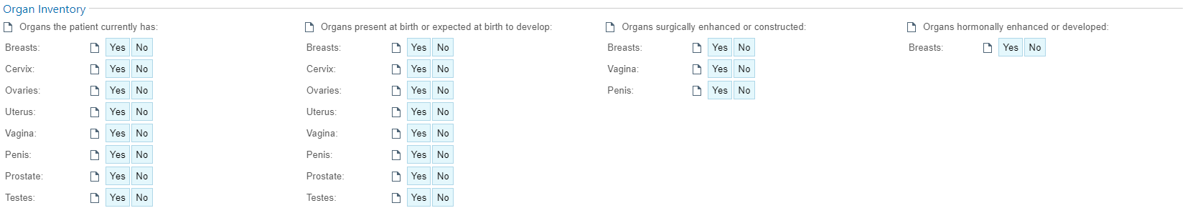
Organ Inventory in Epic at MaineHealth

Slide 11
Screen it if you got it!

Slide 12

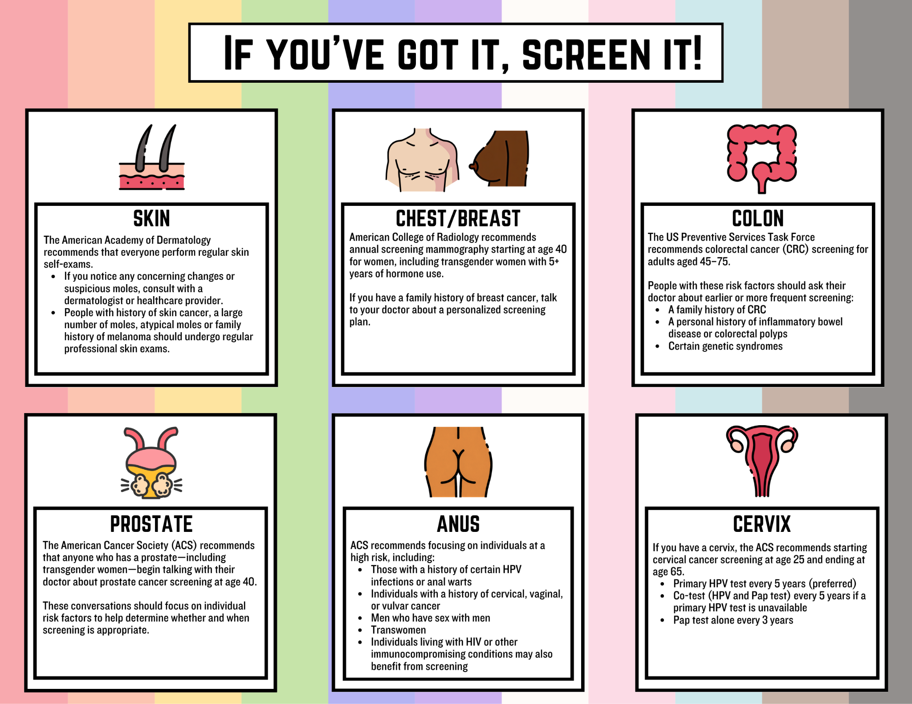

Slide 13
A Note on the Available Evidence…
There are an abundance of expert opinions and society guidelines.
This can make counseling patients difficult for primary care providers!
This is also true for our cis-gender patients, but providers feel more comfortable discussing, in general

Slide 14
Breast/Chest Cancer Screening

Slide 15
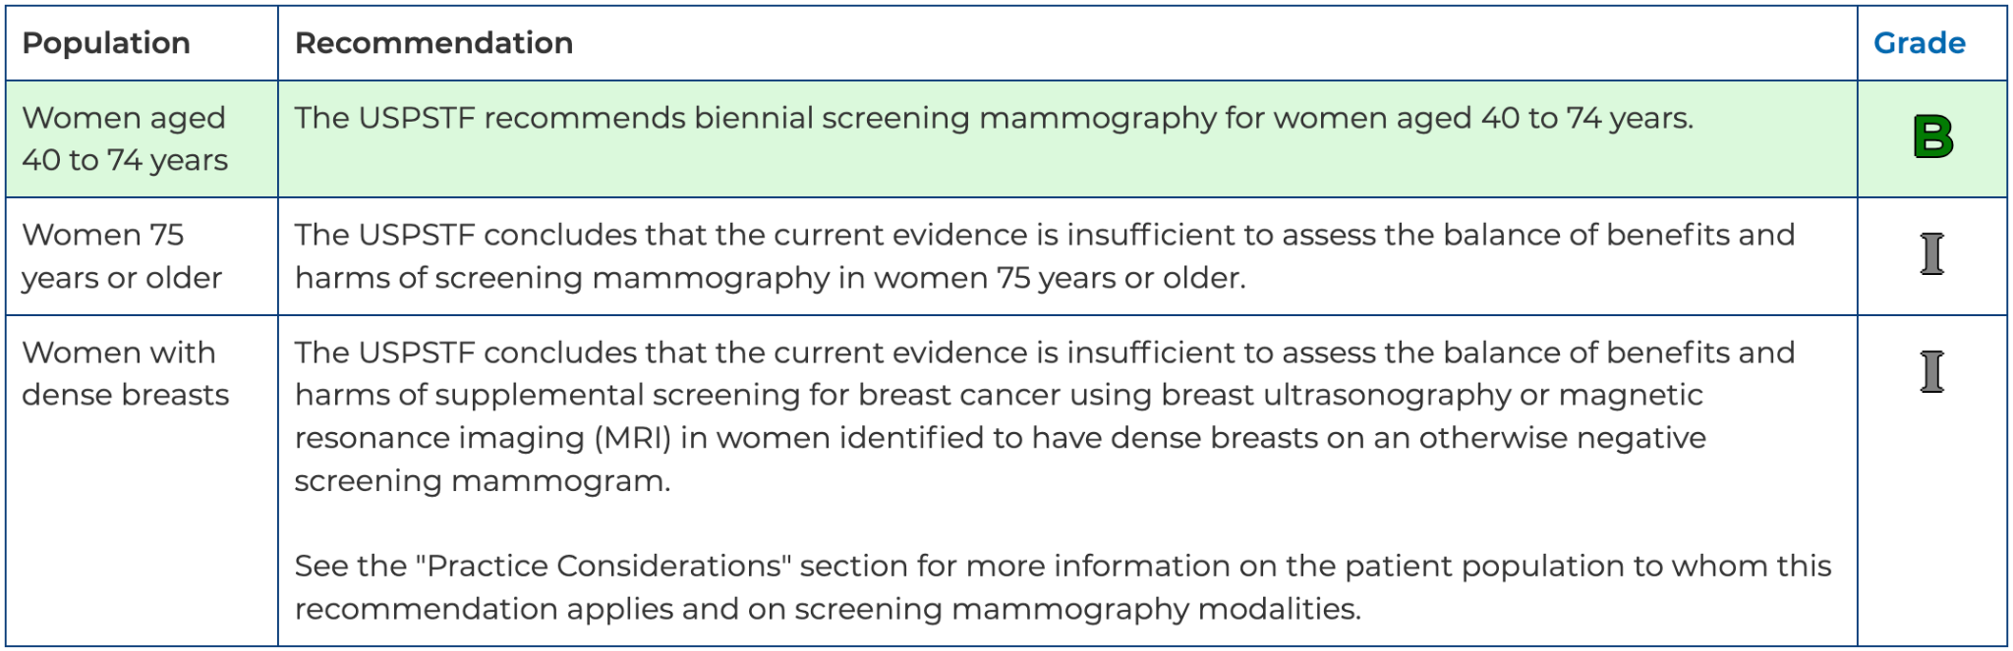
USPSTF Recommendation

Slide 16
Breast/Chest Cancer Screening
Was breast/chest tissue the result of endogenous hormones (AFAB)?
Has the patient had surgery on the breast/chest tissue?
Has the patient been taking estradiol therapy for gender affirmation? If yes, for how long?

Slide 17
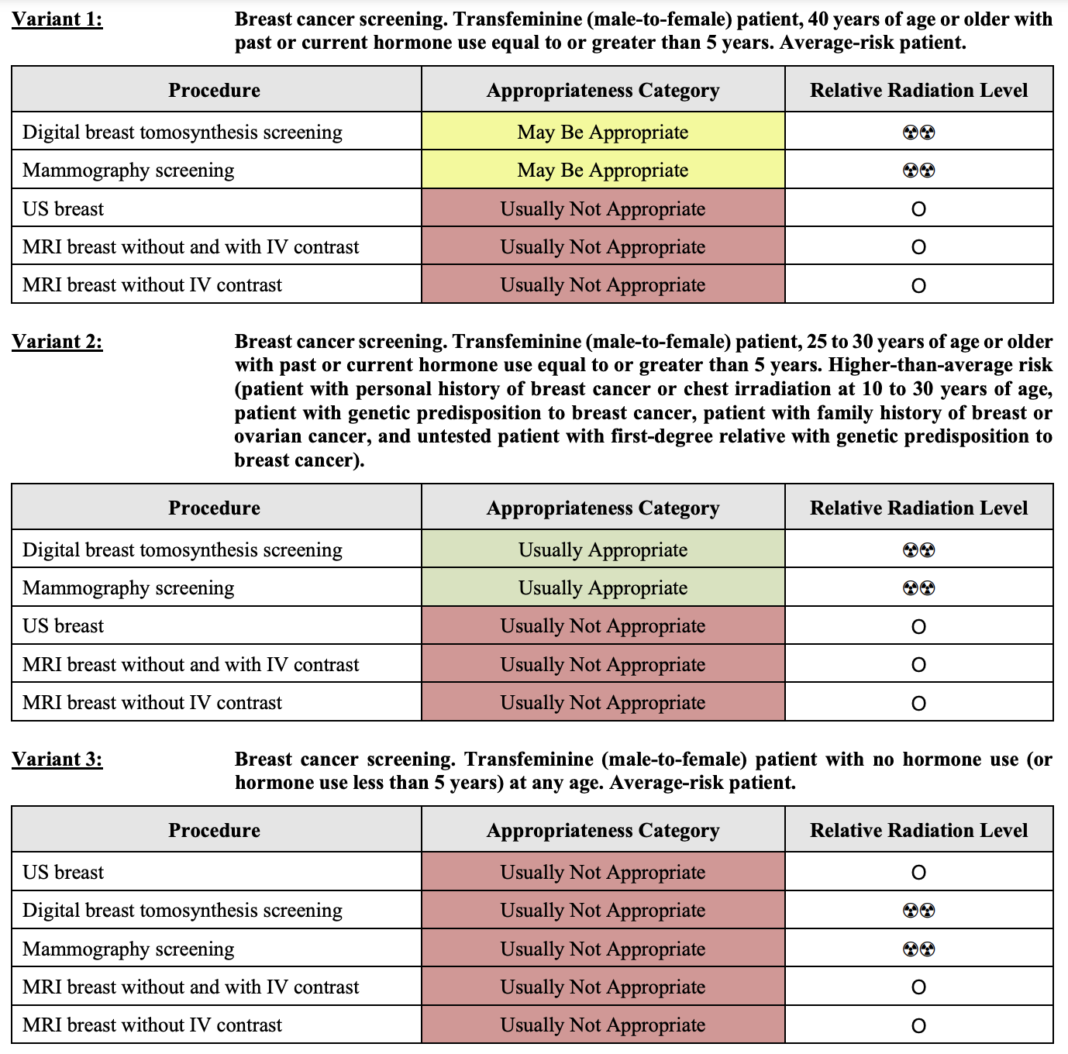
Select Recommendations for Screening TGD Patients
AFAB patient, no mastectomy: encourage same screening as for cis-women
AFAB patients s/p mastectomy: ?chest exams annually, ?MRI or US if strong family history or with SDM¹
AFAB patients on testosterone therapy: no increased risk for breast cancer compared to cis-women; ?may be at lower risk²
AMAB patients on estradiol therapy: increased risk compared to cis-men, but lower than cis-women; if on estradiol for 5-10 years, consider screening schedule same as cis-women
FYI: Breast tissue is denser for patients AMAB, false positives more common than for cis-women on mammography
Notes:
Parikh U, Mausner E, Chhor CM, Gao Y, Karrington I, Heller SL. Breast Imaging in Transgender Patients: What the Radiologist Should Know. Radiographics. 2020 Jan-Feb;40(1):13-27. doi: 10.1148/rg.2020190044. Epub 2019 Nov 29. PMID: 31782932.
de Blok C J M, Wiepjes C M, Nota N M, van Engelen K, Adank M A, Dreijerink K M A et al. Breast cancer risk in transgender people receiving hormone treatment: nationwide cohort study in the Netherlands BMJ 2019; 365 :l1652 doi:10.1136/bmj.l1652

Slide 18
Cervical Cancer Screening

Slide 19
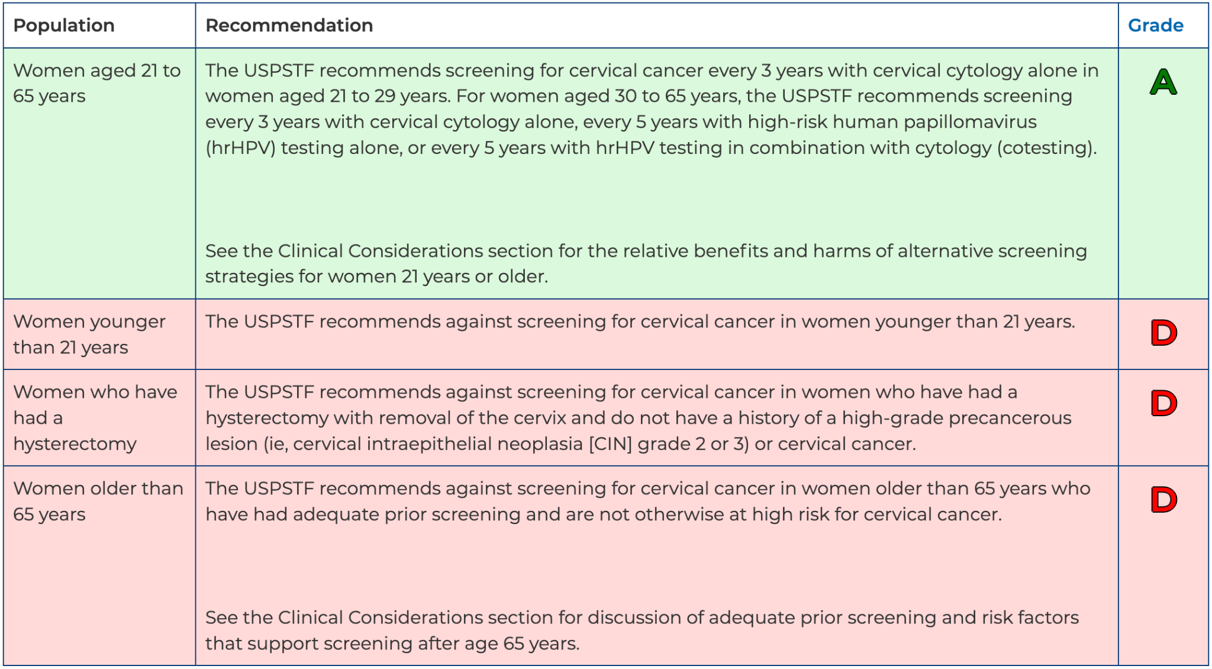
USPSTF Recommendations

Slide 20
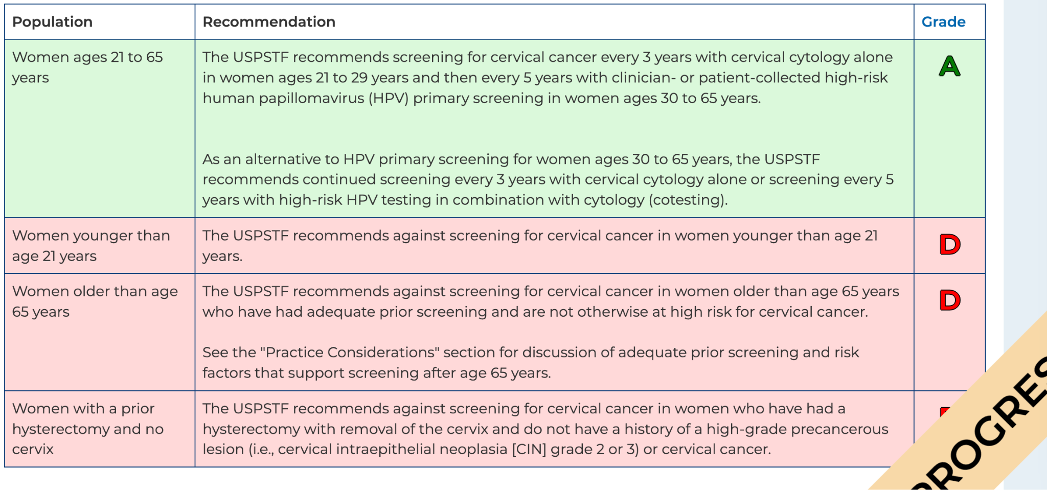

Slide 21
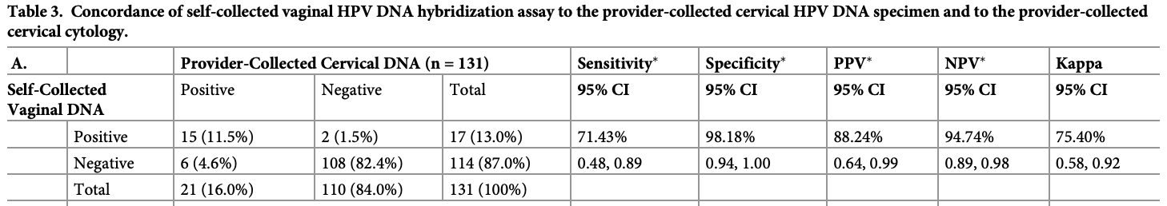
Select Recommendations for Screening TGD Patients
AFAB with cervix: follow cis-women USPSTF/ASCCP/ACS guidelines
FYI: testosterone exposure causes 10 times increased rate of inadequate sample for cervical cancer screening, likely due to atrophy (proportional to dose and duration of testosterone exposure)¹
Best Practices to Consider: Self-collection of hrHPV DNA²; Use smallest speculum possible, consider anoscope; Use multiple tools to sample; Empower patient to dictate the pace of exam; Offer to explain procedure/exam/show tools used; Allow patient to insert speculum; Allow distraction techniques; Consider pre-medication with BZD
Can offer the patient 1-2 weeks of topical/PV estradiol cream/tablets prior to speculum exam
Notes:
Peitzmeier SM, Reisner SL, Harigopal P, Potter J. Female-to-male patients have high prevalence of unsatisfactory Paps compared to non-transgender females: implications for cervical cancer screening. J Gen Intern Med. 2014 May;29(5):778-84
Reisner SL, Deutsch MB, Peitzmeier SM, White Hughto JM, Cavanaugh TP, Pardee DJ, McLean SA, Panther LA, Gelman M, Mimiaga MJ, Potter JE. Test performance and acceptability of self- versus provider-collected swabs for high-risk HPV DNA testing in female-to-male trans masculine patients. PLoS One. 2018 Mar 14;13(3):e0190172. doi: 10.1371/journal.pone.0190172. PMID: 29538411; PMCID: PMC5851532.
Peitzmeier SM, Khullar K, Reisner SL, Potter J. Pap test use is lower among female-to-male patients than non-transgender women. Am J Prev Med. 2014;47(6):808-812. doi:10.1016/j.amepre.2014.07.031

Slide 22
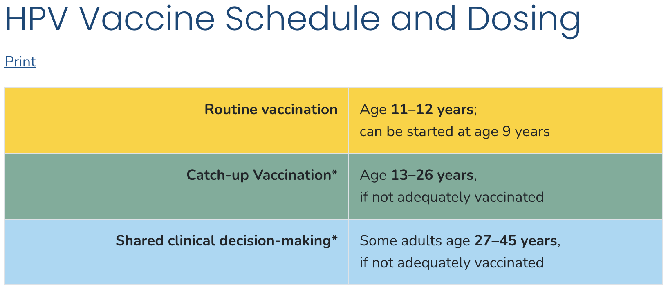
Notes:
https://www.cdc.gov/hpv/hcp/schedules-recommendations.html

Slide 23
Ovarian and Endometrial Cancer Screening

Slide 24
Select Recommendations for Screening TGD Patients
Endometrial Cancer
Ovarian Cancer
Currently no evidence to suggest that screening is indicated
Endometrium when patient on testosterone is either proliferative¹ or atrophic², no evidence of increased incidence of hyperplasia¹
Vaginal bleeding should be evaluated as would be done for cis-women
No evidence to routinely recommend primary prevention with hysterectomy
Currently no evidence to suggest that screening is indicated (in line with USPSTF)
Histopathology of oophorectomy specimens from patients AFAB on testosterone for gender affirmation show no increased incidence of pathologic findings³
No evidence to routinely recommend primary prevention with oophorectomy
Notes:
Frances W. Grimstad, Kylie G. Fowler, Erika P. New, Cecile A. Ferrando, Robert R. Pollard, Graham Chapman, Veronica Gomez-Lobo, Meredith Gray, Uterine pathology in transmasculine persons on testosterone: a retrospective multicenter case series, American Journal of Obstetrics and Gynecology, Volume 220, Issue 3, 2019, Pages 257.e1-257.e7
Grynberg M, Fanchin R, Dubost G, Colau J-C, Brémont-Weil C, Frydman R, et al. Histology of genital tract and breast tissue after long-term testosterone administration in a female-to-male transsexual population. Reprod Biomed Online. 2010 Apr;20(4):553-8.
Frances W. Grimstad, Kylie G. Fowler, Erika P. New, Cecile A. Ferrando, Robert R. Pollard, Graham Chapman, Meredith Gray, Veronica Gomez Lobo, Ovarian Histopathology in Transmasculine Persons on Testosterone: A Multicenter Case Series, The Journal of Sexual Medicine, Volume 17, Issue 9, 2020

Slide 25
Prostate and Testicular Cancer Screening

Slide 26
Select Recommendations for Screening TGD Patients
Prostate Cancer
Testicular Cancer
Adhere to USPSTF recommendations for cis-men
Consider lower abnormal PSA cut off of 1.0ng/mL as elevations above this for a patient with suppressed testosterone (from GAHT, orchiectomy) may be indicative of abnormal prostate size¹
After vaginoplasty, prostate best palpated anteriorly through neovagina (see next slide)
Currently no evidence to suggest that screening is indicated (in line with USPSTF)
Notes:
Trum HW, Hoebeke P, Gooren LJ. Sex reassignment of transsexual people from a gynecologist's and urologist's perspective. Acta Obstet Gynecol Scand. 2015;94(6):563-567. doi:10.1111/aogs.12618

Slide 27
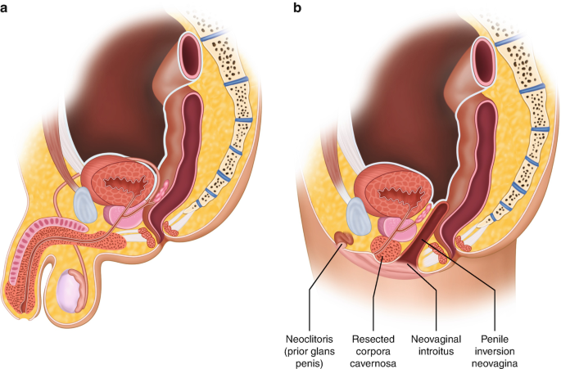
Notes:
Drinane, J.J., Santucci, R.A. (2021). Surgical Anatomy: Vaginoplasty. In: Nikolavsky, D., Blakely, S.A. (eds) Urological Care for the Transgender Patient. Springer, Cham. https://doi.org/10.1007/978-3-030-18533-6_6

Slide 28
Lung and Colon Cancer Screening

Slide 29
Select Recommendations for Screening LGBTQ+ Patients
Recommend screening per USPSTF guidelines for cis-gender patients

Slide 30
Anal Cancer Screening

Slide 31
USPSTF Recommendations

Slide 32
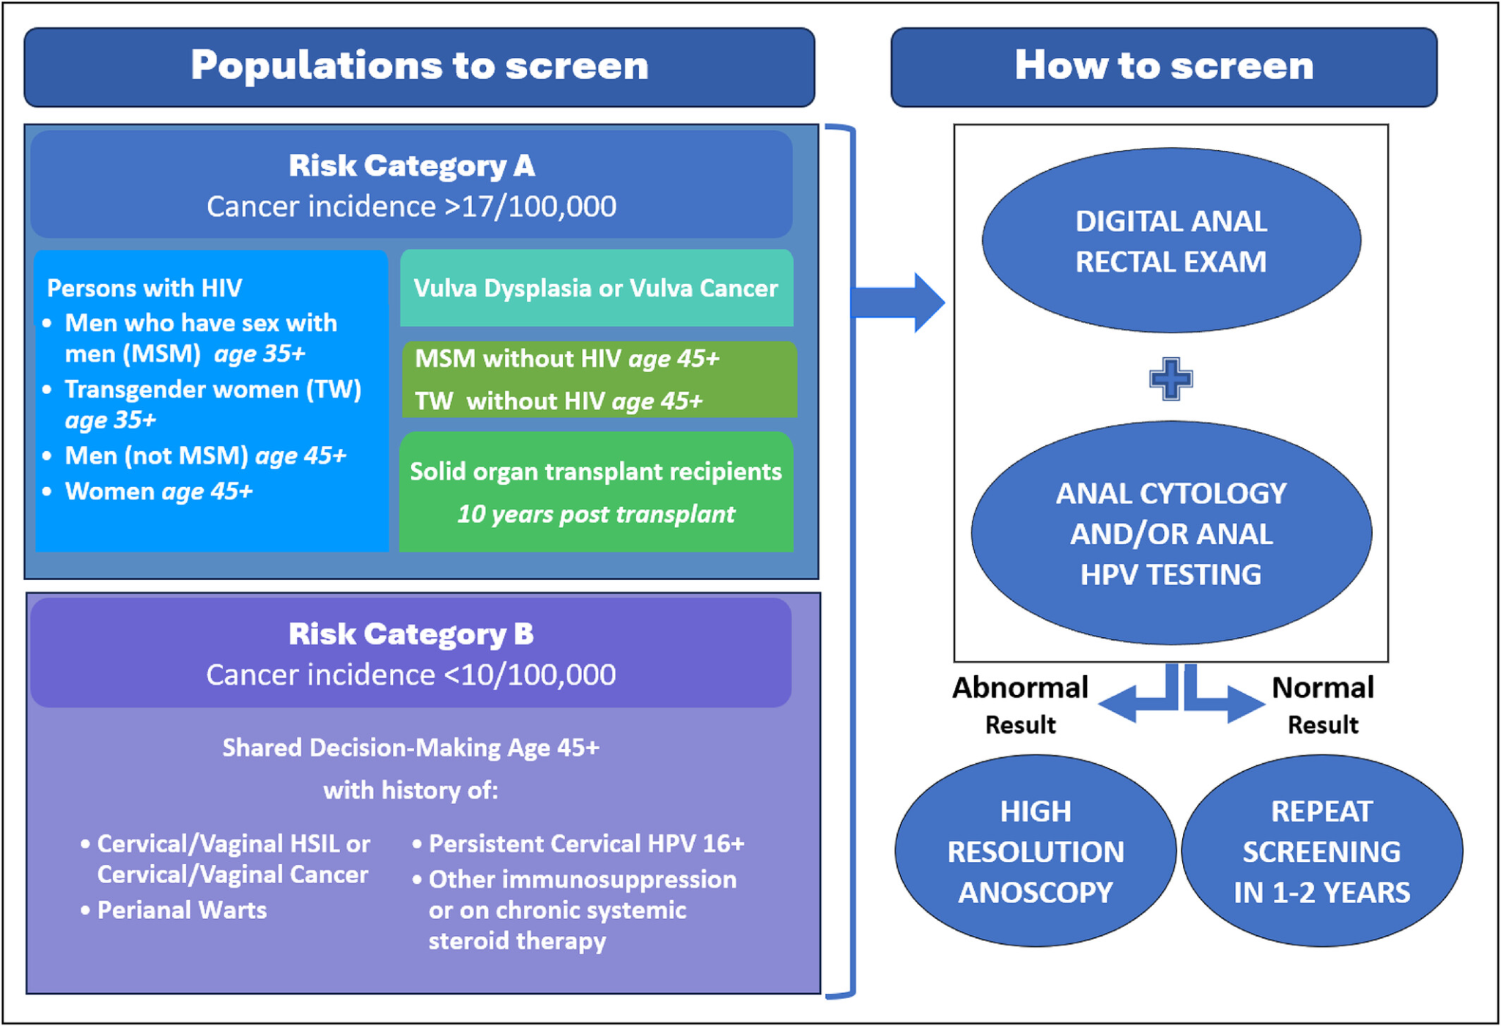
International Anal Neoplasia Society’s Consensus Guidelines for Anal Cancer Screening
Notes:
Stier EA, Clarke MA, Deshmukh AA, et al. International Anal Neoplasia Society's consensus guidelines for anal cancer screening. Int J Cancer. 2024;154(10):1694-1702. doi:10.1002/ijc.34850
https://www.asccp.org/Assets/6e8dcdcb-d093-42ef-97cd-70a8c30dbf3e/638641643094670000/asccp-practice-advisory-anal-cancer-screening-final-pdf

Slide 33
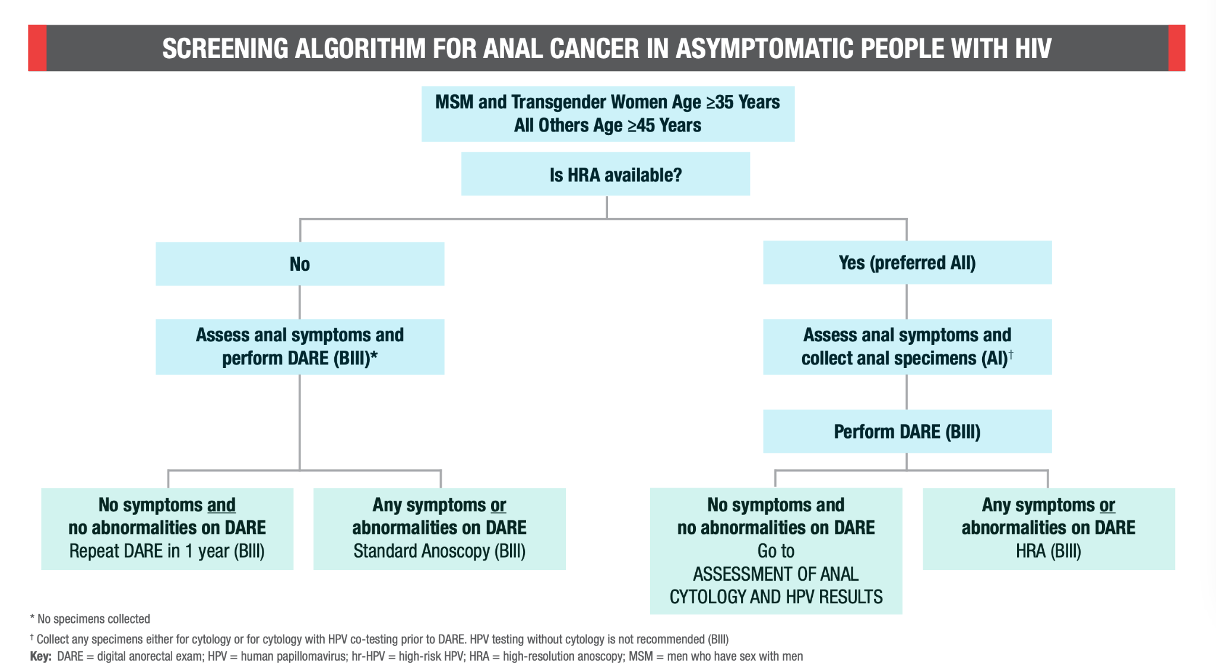
Notes:
Centers for Disease Control and Prevention (CDC). Human papillomavirus disease. HIV Clinical Guidelines: Adult and Adolescent Opportunistic Infections. Accessed February 5, 2025. Available from: https://clinicalinfo.hiv.gov/en/guidelines/hiv-clinical-guidelines-adult-and-adolescent-opportunistic-infections/human?view=full

Slide 34
Please reach out with questions!
Jennifer Daigle (she/her), APRN-CNP
Tobias Nicholson (he/him), MD, ScM
Clinical Program Coordinator of Gender-Affirming Services
Greater Portland Health
jdaigle@greaterportlandhealth.org
Leadership in Preventive Medicine Fellow
Family Medicine Physician
MaineHealth
tobias.nicholson@mainehealth.org

